Slide 1

NARFE-hosted Microsites: What you need to know
Linda Wallers
October 25-26, 2024
Region IX Symposium
Notes:
Welcome to the NARFE-hosted Microsites. Word Press is sophisticated web developing software, that looks harder to use than it is. You do not have to build your website from scratch! The microsite Working group has done the hard part for you – they constructed the framework that you will use to communicate with your members. All you But do is fill it with content. But be aware:

Slide 2
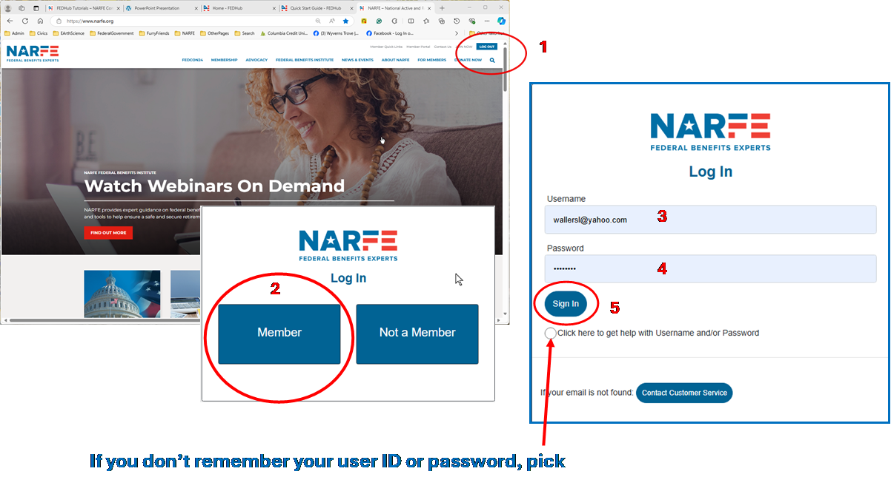
NARFE-hosted Microsite
To see everything, Log in.
If you only want to see information available to everyone, just add a back slash and site name to the NARFE URL.
Example:
www.narfe.org/chapter0131
Notes:
The websites are viewable by anyone who comes to the NARFE website, look s for Find A Chapter, or knows what and how to ask for the site. But not all of the chapter or federation information is visible to everyone. Any documents or information that includes personally identifiable information about officers or members is behind a security wall that requires a user ID and password to access. This is intended to reduce the access of valuable personal information from scammers. If you want to see everything on a site, LOG IN.

Slide 3
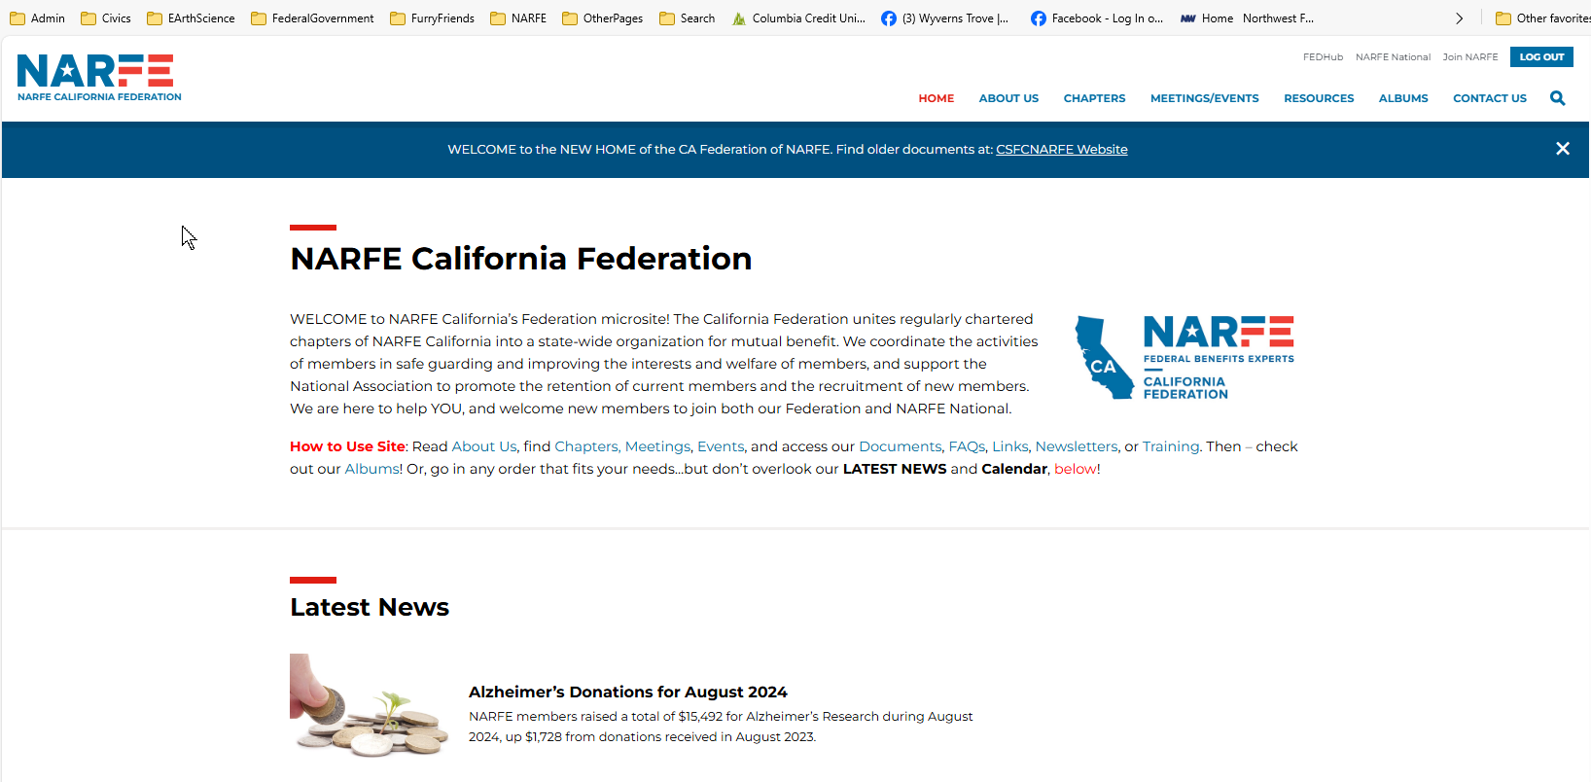
NARFE-hosted Microsite: Dashboard Menu
Once you are logged in you will be taken to the home page of the site with all of its content fully available for you to view.
Notes:
Logging in takes you to the HOME page which should include a summary of info about your chapter or federation and may include a section on POSTS, brief and time-constrained notices.

Slide 4
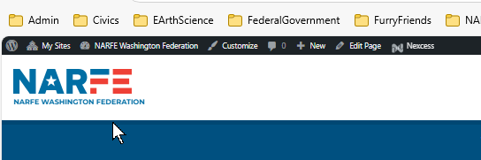
NARFE-hosted Microsite: Dashboard Menu
Microsite administrators will see an additional menu that allows them to edit the site.
Notes:
The WordPress menu is above the NARFE logo.
It includes My Sites, a list of the sites you are authorized to edit;
Name of the site you put in the URL;
Customize and Comments are advanced functions that I won’t cover here;
New is a list of the menu items you will use most and those are found on the main dashboard menu, along with Edit Page, that we’ll talk more about in a minute;
Nexcess is another advanced function that I believe is reserved for NARFE National, so you can ignore that icon.

Slide 5
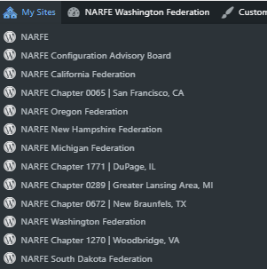
NARFE-hosted Microsite: Dashboard Menu
Microsite administrators will see an additional menu that allows them to edit the site.
Notes:
This what the My Sites menu looks like. Your site will be on the list, but, since you have the right URL, you don’t need to fish for where you want to be.

Slide 6

NARFE-hosted Microsite: Dashboard Menu
Microsite administrators will see an additional menu that allows them to edit the site.
Notes:
The Dashboard is the item to pay attention to here – we will cover that in a minute. Themes and menus are on the dashboard, too.
Ignore Customize, and Comments – Comments are not functional, ecause that allows scammers to post to your pages and we don’t want to encourage that activity.

Slide 7
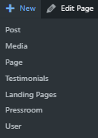
NARFE-hosted Microsite: Dashboard Menu
Microsite administrators will see an additional menu that allows them to edit the site.
Notes:
New also includes items that are on the dashboard. I find going to and using the Dashboard is easiest for me. If you find this dropdown menu easier, you can use it.

Slide 8
NARFE-hosted Microsite: Dashboard Menu
Microsite administrators will see an additional menu that allows them to edit the site.
Notes:
Edit page will take you to an editable version of the page you asked for, in this case, the HOME page.

Slide 9
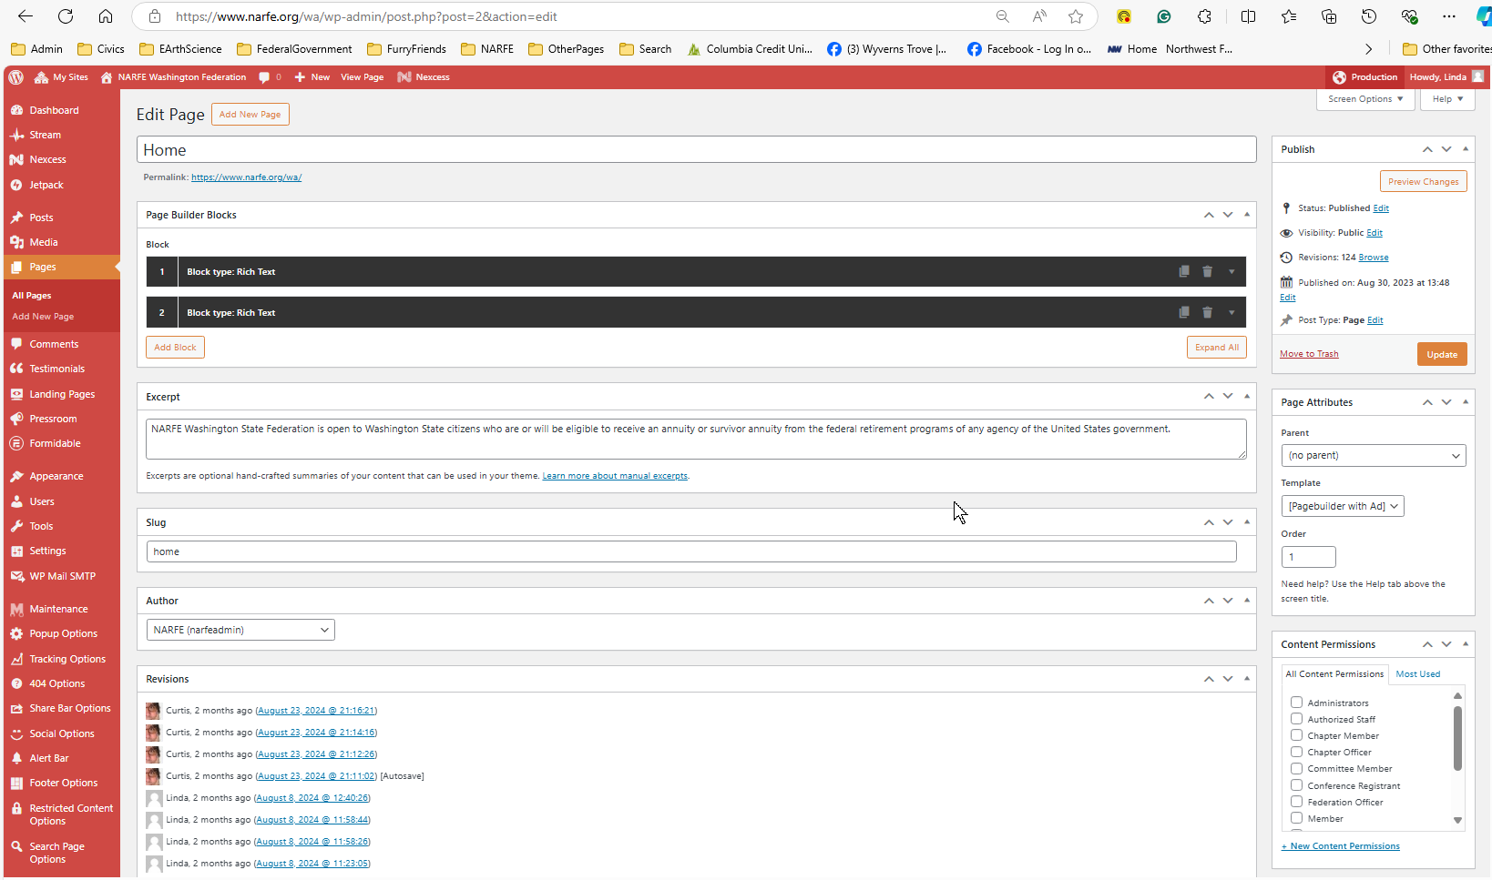
NARFE-hosted Microsite: Dashboard Menu
I know it looks complicated, but, once you know what you need and where to find it, it’s really simple. Most of this you will not use. If you run into a problem, just ask for help.
Notes:
It also gives you the Dashboard menu. Most of the items in the WordPress Dashboard menu (on the left) can be ignored. There is a tutorial on the WordPress Dashboard menu that explains the items that you can bypass and the ones to pay attention to. If you want a copy, I can take your informaotn and email it to you or show you where to find it on the CAB website.

Slide 10
NARFE-hosted Microsite: Dashboard Menu
Notes:
For beginners, he POSTs, MEDIA, and PAGEs are the functions you will use the most.
POSTs are dynamic (changing frequently), brief, and short-term messages for special events or purposes. Show examples.
MEDIA are photos, presentations, spreadsheets, or documents that you upload to the NARFE servers for use and storage.
PAGES tend to be static or change less often such as a page listing your officers for the coming year.

Slide 11
NARFE-hosted Microsite: Dashboard Menu
Notes:
Formidable is a form creator. The Contact Us forms for your officers and the Webmaster will be created before the website is released by the microsite working group. You will rarely, if ever, need this app. However, if you need to build a ballot or a survey, ask for help and you’ll discover how easy it really is to work with.
Appearance is the look and feel of your site. The template has already bee selected, but at some future time, you may want to change your HOME page main menu from this set of functions.
USERS is where you will select anyone other than yourself who will have access to editing a page or post. For federations, you may want to give delegate some access to the President, Secretary, Membership Chair, and legislative chair to help you maintain the site. When a new Webmaster is selected, this is where you will add them to the list of editors/administrators BEFORE you remove yourself.

Slide 12
NARFE-hosted Microsite: Dashboard Menu
Notes:
The ALERT BAR is the blue bar that appears above the federation or chapter info on each page, and it is for special info, such as elections, member death notices, reminders, etc.

Slide 13
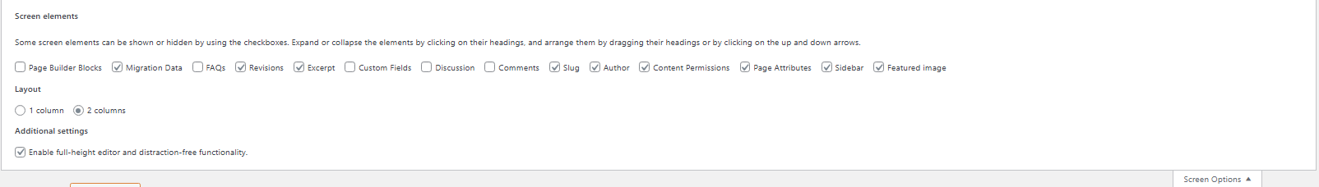
NARFE-hosted Microsite: Dashboard Menu
Notes:
Screen Options and Help are in the upper right corner. Screen options include Builder Blocks for page sections, Excerpts, Author, Content permissions, and Featured images. One or more of these features could already be on your page along the right side, below the PUBLISH and PAGE ATTRIBUTES sections. When you select one of these options it opens on the right side and the work boxes can be rearranged by drag and drop. I normally keep PUBLISH and PAGE ATTRIBUTES first with others falling below them, by order of use. You may want to add or remove the sections from some pages to see the effect and to streamline your workflow.

Slide 14
NARFE-hosted Microsite: Dashboard Menu
Notes:
This page has Content Permissions selected. Content permissions give you the ability to restrict who sees you page, so it comes in handy. Remember, you only want to restrict pages with peronally identifiable info. Your other pages you want potential recruits to view.

Slide 15
NARFE-hosted Microsite: Dashboard Menu
Notes:
When using Content Permissions, select viewing for NARFE members only. That would include NARFE HQ administrators, authorized staff, chapter members, committee members, federation officers, and members such as in National-only or out-of-state visitors. Other selections should remain blank.

Slide 16
NARFE-hosted Microsite: Dashboard Menu
Notes:
PUBLISH workbox provides options for drafts (not viewable by the public),

Slide 17
NARFE-hosted Microsite: Dashboard Menu
1
Notes:
PUBLISH workbox provides options for viewing your changes, one a new tab, BEFORE you save. But REMEMBER TO UPDATE/SAVE when you are finished editing and are happy with your result.

Slide 18
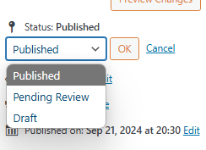
NARFE-hosted Microsite: Dashboard Menu
1
2
Notes:
Published gives the status of your page as either Published and viewable, in draft, or awaiting review.

Slide 19
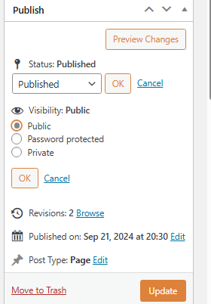
NARFE-hosted Microsite: Dashboard Menu
1
2
3
Notes:
Visibility lets you increase the viewability of your entire page or restrict it to passwords or for your eyes only.

Slide 20
NARFE-hosted Microsite: Dashboard Menu
1
2
3
4
Notes:
Revisions gives you insight into changes that have been made on your page/site, especially if you are not the only person making changes.

Slide 21
NARFE-hosted Microsite: Dashboard Menu
1
2
3
4
5
Notes:
You can see when the most recent changes were published.

Slide 22
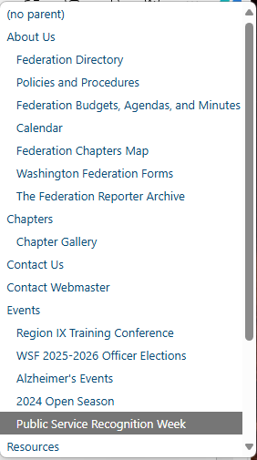
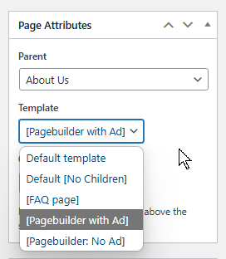
NARFE-hosted Microsite: Dashboard Menu
Notes:
PAGE Attributes allows you to add second level “Child” pages to main menu “Parent” pages – example.

Slide 23
NARFE-hosted Microsite: Dashboard Menu
Notes:
You can also change the page template to give you more flexibility - example.

Slide 24
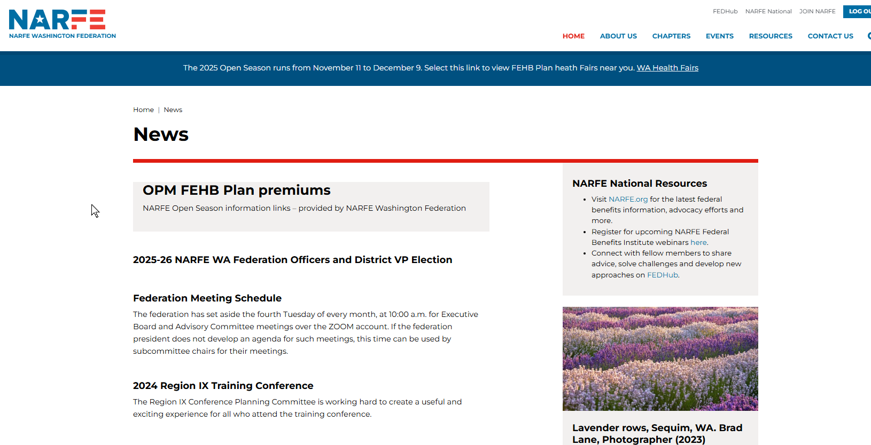
NARFE-hosted Microsite: Dashboard Menu
Notes:
Example – default page template with NARFE National advertising/links. This messes up the text on some pages. So, in those cases, we suggest using one of the pagebuilder options.

Slide 25
If you have questions , please ask.
If you found this useful, let me know.
You can find other tutorials on the Configuration Advisory board (CAB) website, under Quick Links.
Linda Wallers
October 25-26, 2024
Region IX Symposium
Notes:
This is just an overview. I promise, it is not as hard as it looks. If you are going to have a NARFE hosted website, which will make transitioning between webmasters much easier, be sure to take the training and use the FEDHub Webmasters Unite! Community for your questions.

