Slide 1

Introduction to the NARFE National Website
Linda Wallers
October 25-26, 2024
Region IX Symposium
Notes:
Welcome to the new NARFE web site. Let’s look around.

Slide 2
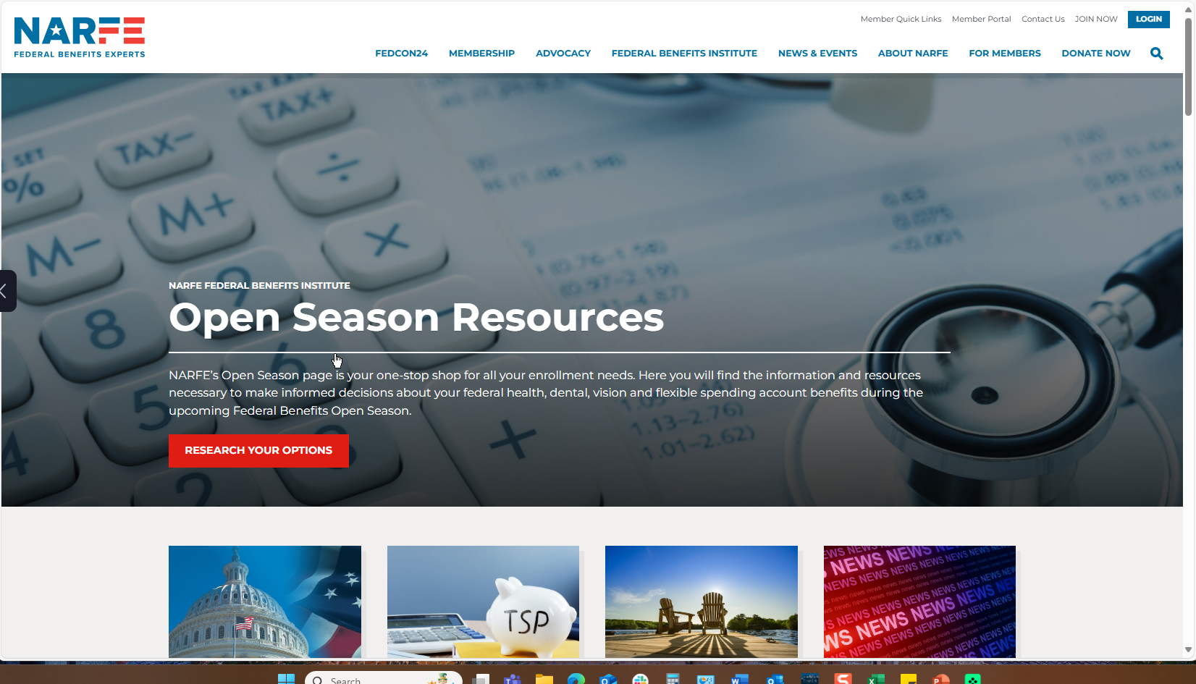
NARFE website
Notes:
You can scroll down the page and find links to the Advocacy Center and to FEDHub, but I’ll let you explore the page. Notice that there are two menus. The top menu

Slide 3
NARFE website
Notes:
Or NARFE site navigation menu, at the top right of the page, where you will see the blue LOGIN button on the far right and a JOIN NOW link to its left. Contacts us provides information on how to contact NARFE, either by mail, by phone, or fill in the contact form with your questions.
The Member Portal takes you to your ACCOUNT information. We will come back to that later.

Slide 4
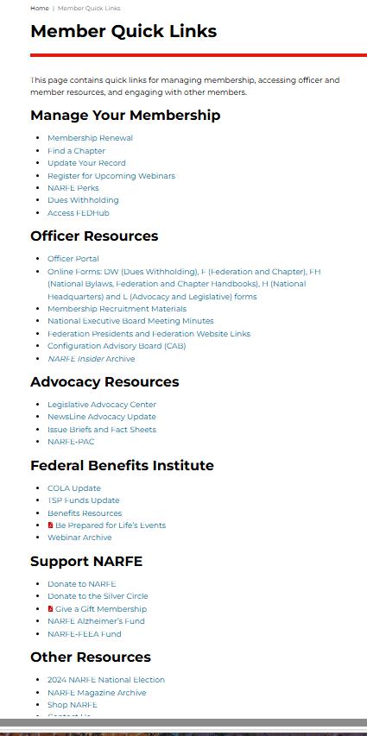
NARFE website
Notes:
Member Quick Links consists of a page of links, by category, with information that members and officers frequently use, all in one place. Simple and easy to find.

Slide 5
NARFE website
Notes:
The main NARFE menu has categories of information available from six tabs: Membership, Advocacy, Federal Benefits Institute, News & Events, About NARFE, and For Members- each with additional dropdown menu items. We will go over each of these main menu tabs and explain what they contain.

Slide 6
NARFE website
Notes:
For special events or membership/fund drives, you may see additional tabs such as the FEDCon24 and Donate Now tabs, taking you to pages with information on those options.

Slide 7
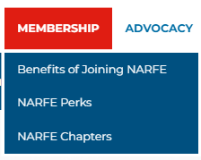
NARFE main menu
Notes:
Benefits of Joining NARFE has information on who can join and what members get with their NARFE membership. A JOIN TODAY button is on the bottom of the page.
NARFE Perks consists of a list of Affinity Partners that offer wonderful discounts for NARFE members. From insurance telecommunications, travel, pre-planning, products, moving services, wellness, and NARFE merchandise – members can save money on everyday purchases from NARFE’s Affinity Partners. This page also has a JOIN NOW button.
NARFE Chapters will take members and non-members to a page with information about chapters, what they do, and how to find a chapter near you using the Find a Chapter tool. If you are already in a chapter and want to give your members a spotlight on their activities, at the bottom of this page you can find out how to submit a photo for the Federation or Chapter Spotlight.

Slide 8
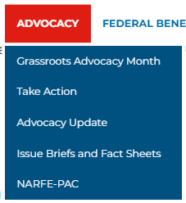
NARFE main menu
Notes:
NARFE’s Grassroots Advocacy Month engages members in advocacy activities when their members of Congress return to the district and state for the long summer congressional recess. The campaign plays an essential role in protecting the earned pay and benefits of the federal community and keeps federal workers’ and retirees’ issues and priorities fresh in lawmakers’ minds as thousands of other constituents are competing for their attention discussing other concerns.
There are webinars (video and slides) to help members and non-members start and to run a social media campaign and tools to aid the process including a way to submit your own “Why I became an Advocate” video to NARFE, with a sample script. Further down on the page members and non-members can find information on NARFE’s Legislative Priorities and links to other helpful information and sites.
Take Action will take members and non-members to the Legislative Action Center where they can find not only legislative issue information but a way to directly contact their Congresspersons and Senators with prewritten and editable letters and get help in writing a personal letter. You can also sign up for alerts, find legislation, view your member’s Scorecards on key actions, and find your elected officials and candidates.
Advocacy Update provides the latest news on where things stand on various issues in front of Congress and the Senate.
Issues Briefs and Fact Sheets provide links to issue briefs and fact sheets and useful information on state-by-state advocacy efforts.
NARFE PAC protects NARFE members’ pay and benefits by raising and spending money to elect members of Congress who support the federal community. The PAC also helps build strong relationships with lawmakers. NARFE PAC is a Members Only site

Slide 9
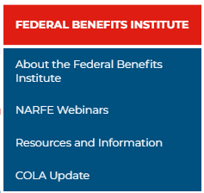
NARFE main menu
Notes:
About the Federal Benefits Institute serves as a gateway to live and recorded learning events and valuable resources for federal employees. There is a Contact the Institute form where members and non-members can submit questions about benefits. The Federal Benefits Institute is a member-only resource; however, the benefits experts are available to help ALL federal employees better understand and make full use of their federal benefits.
NARFE Webinars give members and non-members the opportunity to register for the latest offerings from the Federal Benefits Institute. There is normally one new offering every month on a topic of interest to the federal community. Members and non-members need to register for each webinar – for members, it is free; for non-members, the registration fee includes a one-year NARFE membership, which gives them access to all previous offerings.
Resources and Information include career resources and information-packed documents to help you navigate the complicated path toward retirement and beyond. Facts for Feds are short articles that answer questions about complex processes and regulations and White Papers are previously published articles on benefits from NARFE magazine.
COLA Update gives members and non-members the latest information on where the COLA for retirees stands for the current year.

Slide 10
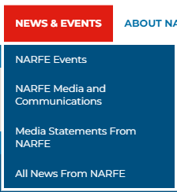
NARFE main menu
Notes:
NARFE EVENTS provides a list of events at both the national and local level that provide valuable training and information designed for both active and retired federal employees. These events offer a diverse look at timely issues facing the federal community with innovative educational sessions, engaging keynote speakers, opportunities to connect with other federal employees and much more. Whether at a national conference or at regional and federation events closer to home, members will find valuable information and guidance, on these pages, to protect and maximize your federal benefits.
NARFE Media and Communications lists links to the NARFE magazine, NewsLine, and Daily News Clips so members can stay on top of their favorite topics.
Media Statements from NARFE links to NARFE press releases on various issues of federal employee and retiree concern.
All News from NARFE links to important and interesting articles from various NARFE departments and from the magazine. These are the kinds of articles that used to be on the front page of the old NARFE website.

Slide 11
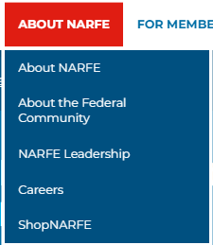
NARFE main menu
Notes:
About NARFE tells the story of how the National Active and Retired Federal Employees Association came to be, describes what it does (acts as your information resource, your legislative voice, and your association), and defines the NARFE Mission Statement:
To support legislation beneficial to current and potential federal annuitants and to oppose legislation contrary to their interests.
To promote the general welfare of current and potential federal annuitants by advising them with respect to their rights under retirement laws and regulations.
To cooperate with other organizations and associations in furtherance of these objectives.
About the Federal Community is the resource page for an explanation of how large the federal community is and where federal employees and retirees live and work – hint: they don’t all live in the Washington DC area. You can also find information on our nation’s veterans – yes, they are federal employees, too.
NARFE Leadership shows who’s who on the NARFE Executive Board and the Executive Team, provides an organizational chart, and has links to the minutes of the NEB Meetings.
Careers offer young and experienced people a chance to work in a fast-paced and challenging office near Washington DC, and an opportunity to interact with the real people in power in government. Heady, yes? Potential applicants can find current open opportunities for career positions and the associated duties, and a contact Human Resources form is available for application.
ShopNARFE has tablecloths, car magnets, pins, badges, shirts/polos/tees, jackets, cups, caps, bumper stickers, Centennial goodies, and more. But you have to be a member to purchase the goods.

Slide 12
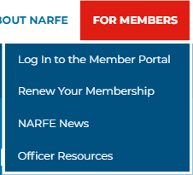
NARFE main menu
Notes:
Log in to the Member Portal takes users to the Welcome page of the Member Portal. Here they can choose one of three options.
Members can click the log-in button for member-only access to their account information and to the Officer Portal (if they are chapter or federation officers) for access to the NARFE Association Management System (AMS) database. SUGGESTION: Use the tiny “Log-In'' button on the top right rather than the Sign-In button in the center. You must then select ”Member” (rather than “Not a member”). This method is preferable to using the “Sign-IN'' button in the center of the page, which leads to a confusing page with a Member Sign-in on the left, and an account creation form on the right. Some members have mistakenly created a “new” account. CAB members have recommended that this page be removed.
Non-members can click either “Register” or “JOIN” to create a NARFE membership account.
Members and non-members alike can access the Support NARFE page where they can contribute to NARFE PAC.
Additional tutorials for functions on the Member and Officer Portals are available from the CAB web page. Contact your chapter or federation officers for more information or contact your CAB representative for help.
Renew Your Membership provides log in access to your profile. Here you can update your profile (your contact information or your membership type),, view registrations for events (such as webinars), view or pay invoices, or modify your settings (change your password or your username). See “Keeping Your Membership Data Current” tutorial for further assistance.
NARFE News links to news about and from NARFE. It also provides information on the next photo contest for the NARFE Calendar, NARFE magazine articles of note, and more.
Officer Resources contains links to essential information, forms and manuals that will ensure your success and smooth operations. Here you will find NARFE Branding Guidelines; Officer Portal information; links to the NEB and Federation Presidents Meetings; membership, service, and publicity officer resources certificates formatted for use in regional, federation, chapter, area, and district awards; matching funds requests; NARFE forms by number; and the F-18 Requisition for printed supplies; To access your membership, log in and select “MEMBER”. Then, provide your username and password. Select one of the option buttons below the login form (find my account email address; I forgot my password; or contact customer service). You can also dial 800-456-8410 or email memberrecords@narfe.org.

Slide 13
NARFE website
Notes:
The Member Portal takes you to your ACCOUNT information.

Slide 14
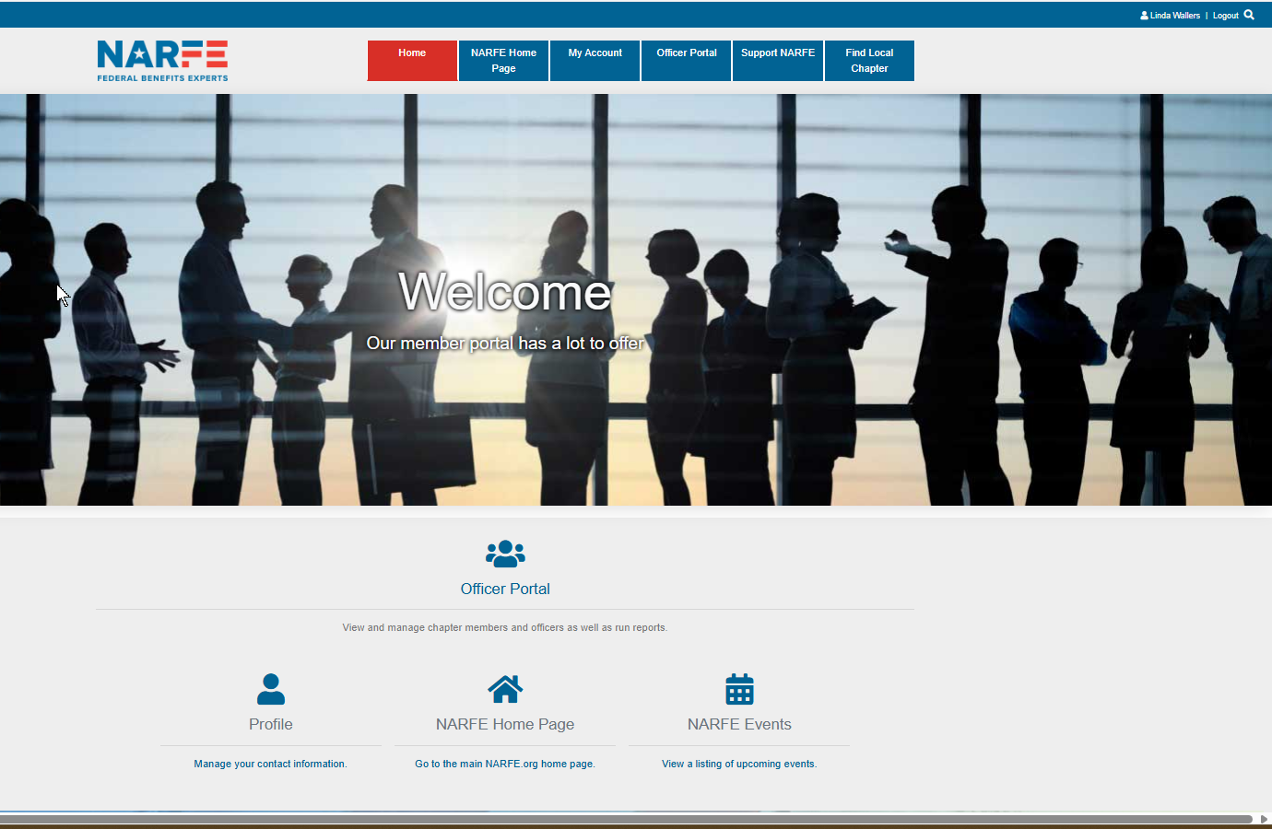
NARFE
Member
Portal
Notes:
For federation and chapter officers, the Officers Portal will take you into the

Slide 15
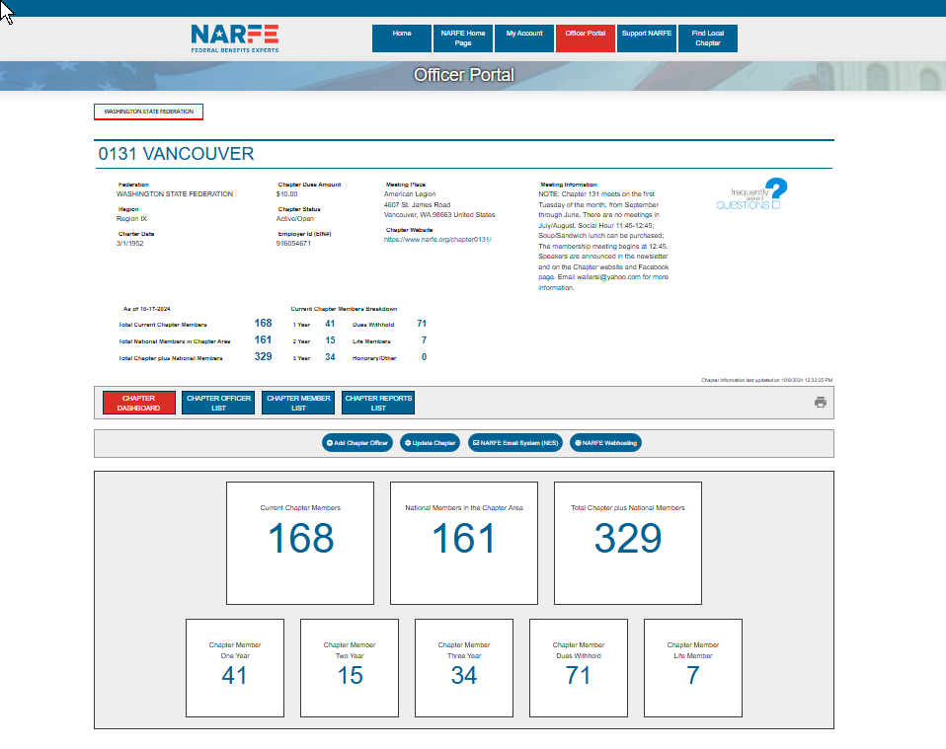
NARFE
Member
Portal
Notes:
Federation or chapter dashboard and, from there, you can retrieve officer reports (M-112 Chapter Activity Report), membership lists, and make changes to your officer roster in the NARFE Association Management system (AMS) using the Dashboard menu buttons. If you are an officer having difficulties with your report, I may be able to help.

Slide 16
NARFE
Member
Portal
Notes:
These buttons will take you back to the NARFE Home Page.

Slide 17
NARFE
Member
Portal
Notes:
Support NARFE takes you a page for NARFE-PAC and donations, including a selection to become a NARFE-PAC Sustainer.

Slide 18
NARFE
Member
Portal
Notes:
A differently formatted Find A Chapter list by Chapter number.

Slide 19
NARFE
Member
Portal
Notes:
Events is a list of current and upcoming Federal Benefits Institute webinars – a useful reference for putting on your website or in your chapter newsletters.

Slide 20
NARFE
Member
Portal
Notes:
Your Profile contains the personal information you choose to make available to

Slide 21
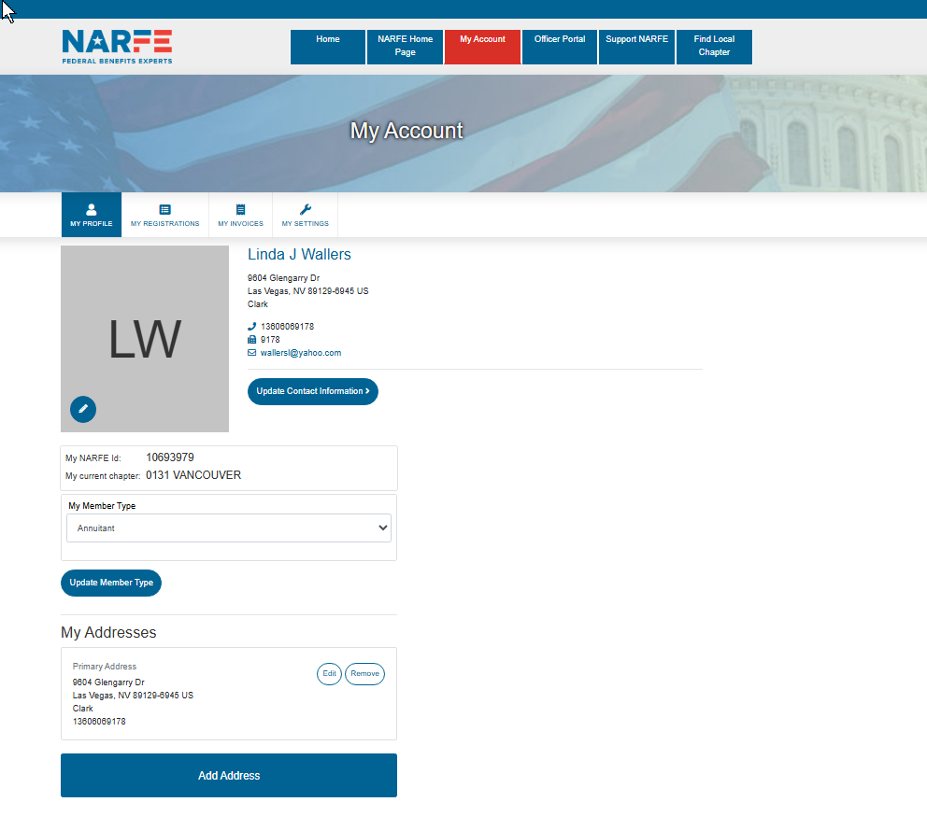
NARFE
Member
Portal
Notes:
NARFE and where you can manage that information.

Slide 22
NARFE website
Notes:
The NARFE SEARCH function works. When you type in election, you get information on NARFE’s National election, including the candidate statements, information on how to vote, and historical election info.

Slide 23
If you have questions , please ask.
If you found this useful, let me know.
You can find other tutorials on the Configuration Advisory board (CAB) website, under Quick Links.
Linda Wallers
October 25-26, 2024
Region IX Symposium
Notes:
That concludes this overview.

