Slide 1

FEDHub: Community of communities
Linda Wallers
October 25-26, 2024
Region IX Symposium

Slide 2
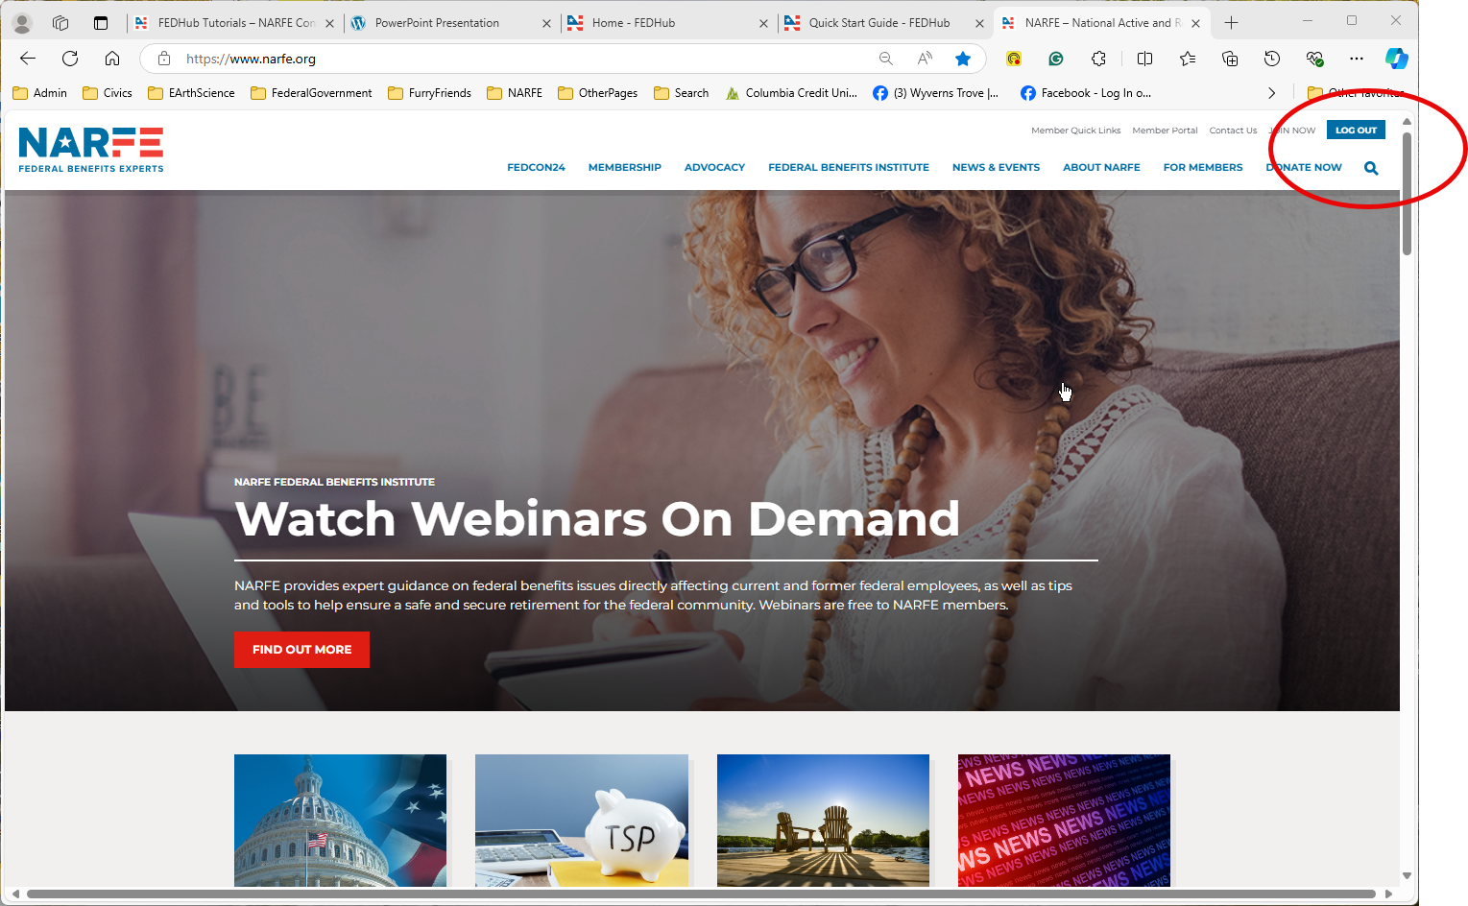
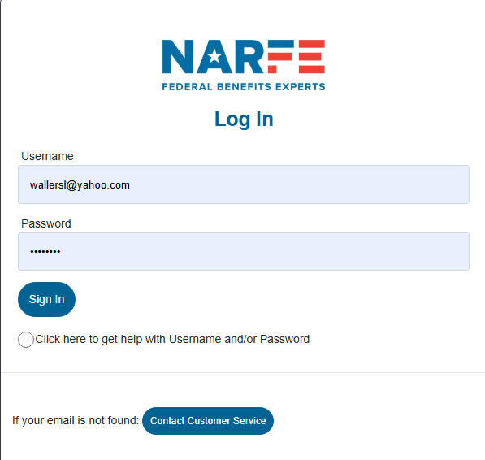
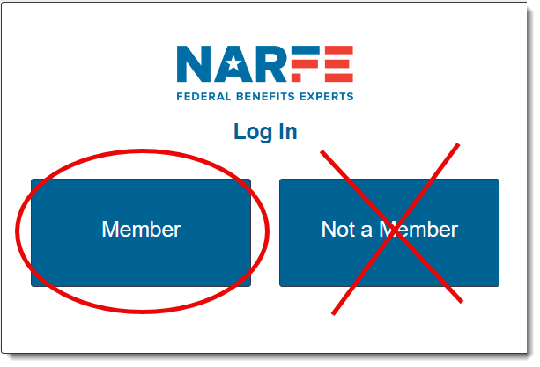
FEDHub Login: https://www.narfe.org
Notes:
Your login ID will be your email address. Your password will not have changed. If you can’t remember your password, select the check box or contact Member Services.
If you have never logged into the new website, you will be asked to create an ID and password.

Slide 3
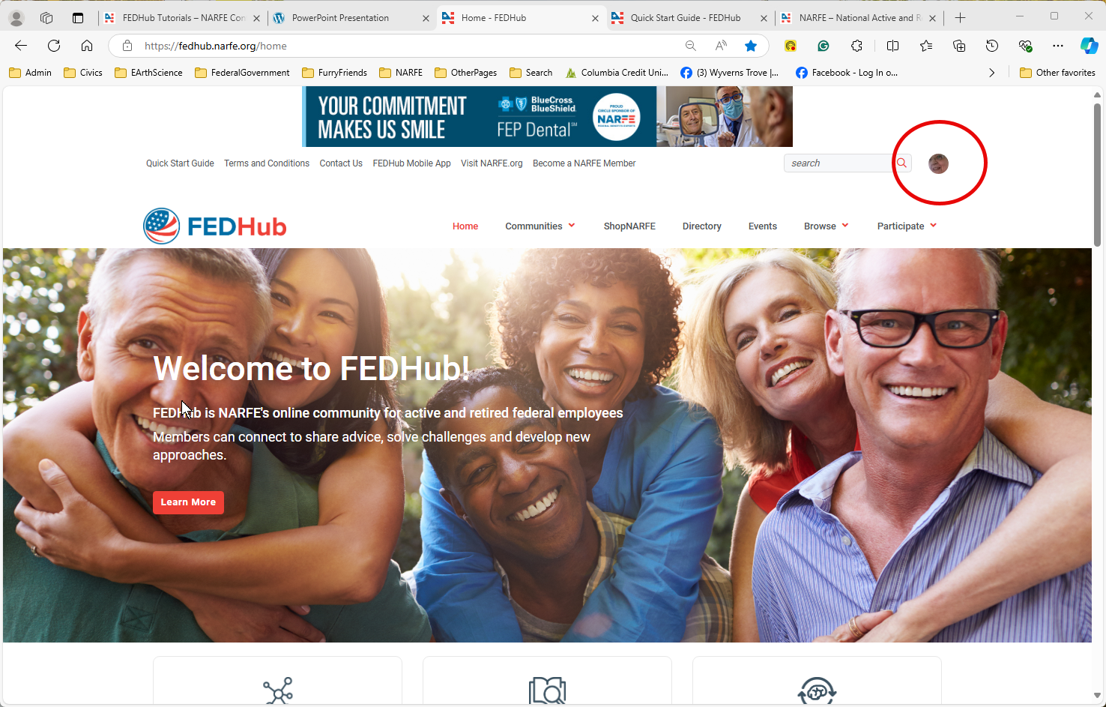
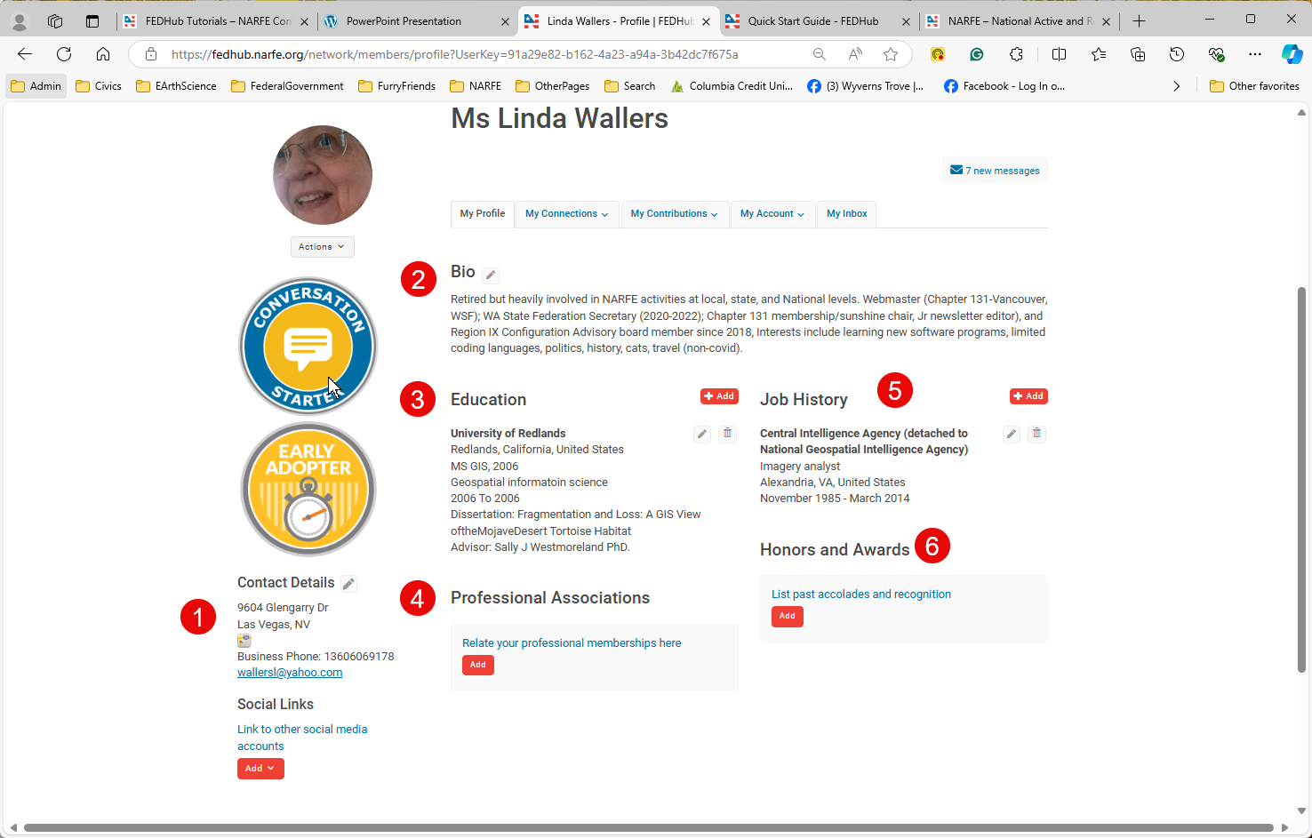
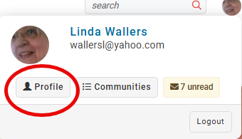
FEDHub Profile

Slide 4
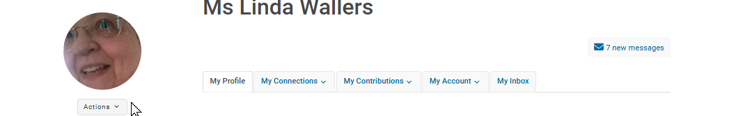
FEDHub Profile
Contacts
Communities
Following
Change picture
Remove picture
Inbox
Privacy settings
Email Preferences
RSS feeds
Community Notifications
Discussion Signature
My summary
Contributions

Slide 5
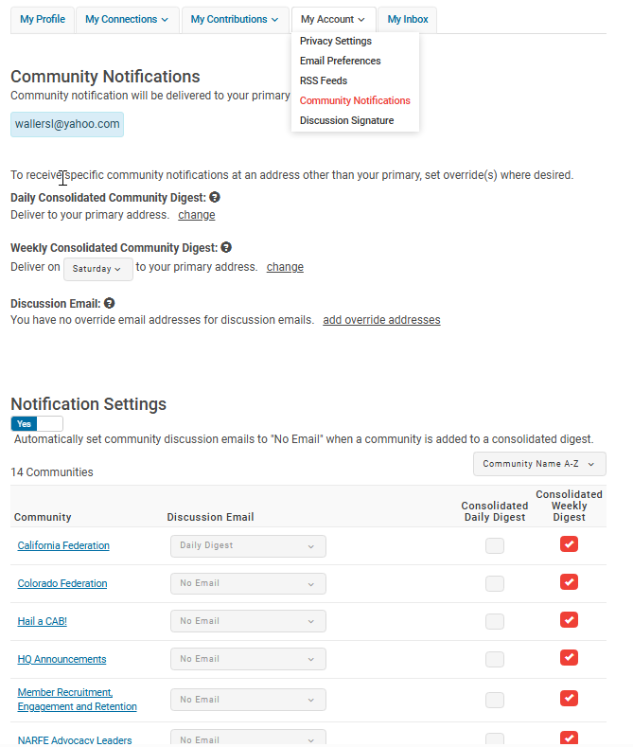
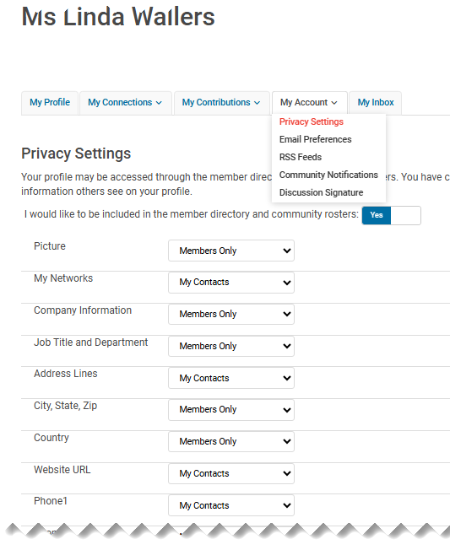
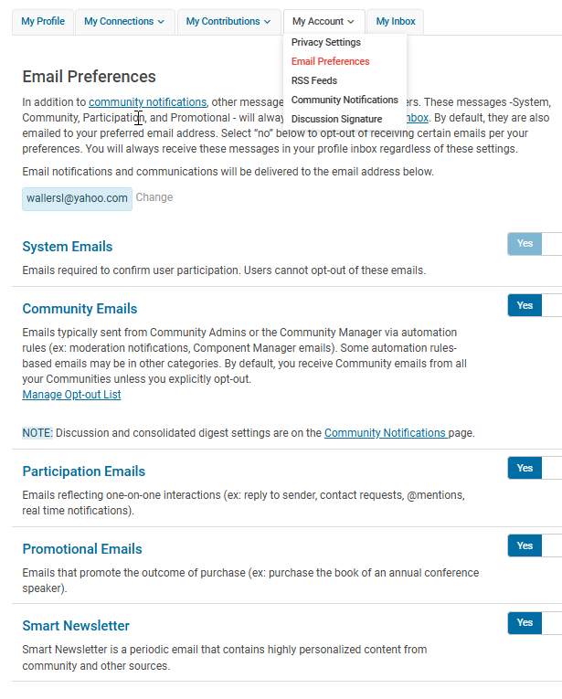
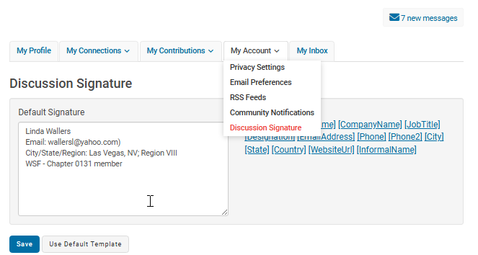
FEDHub My Account

Slide 6
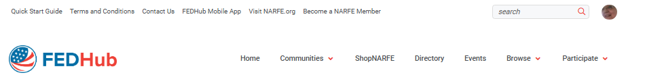
FEDHub
Open forum
My Communities
Federation Communities
Suggested Communities
Discussion Posts
Library Entries
Sponsored Content
NARFE Blogs
Quick Start Guide
Post a Message
Share a File
Post to Your Blog
Help/FAQs

Slide 7
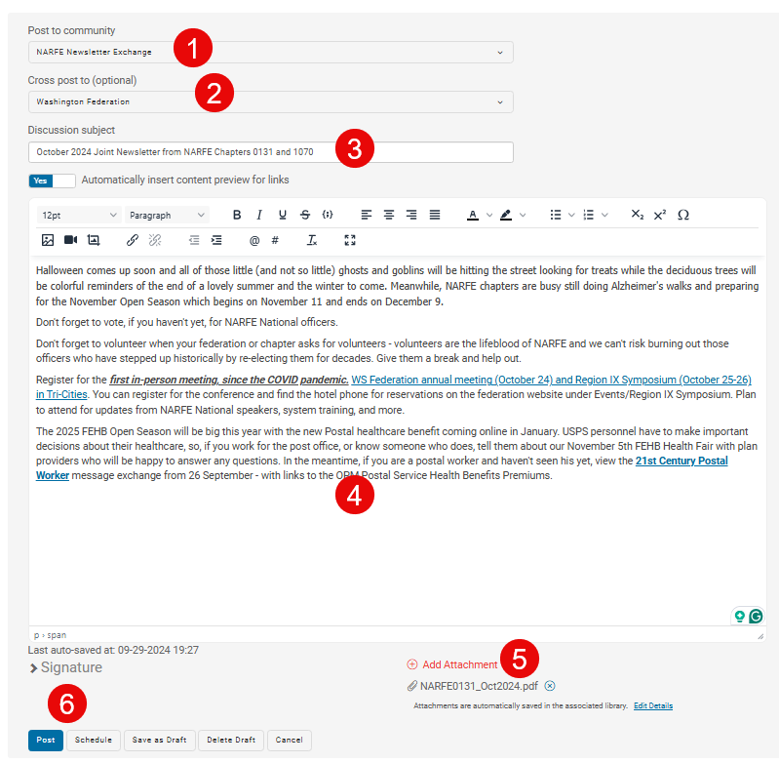
FEDHub: Add a post

Slide 8
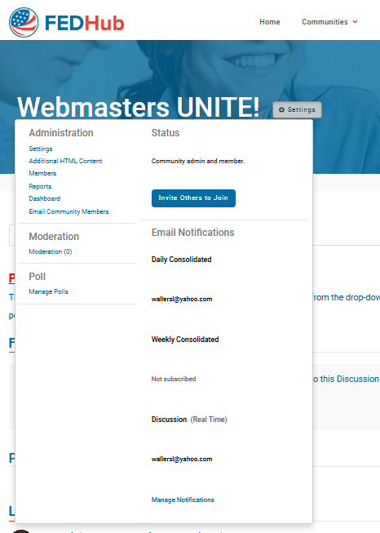
FEDHub: Administrators

