Slide 1

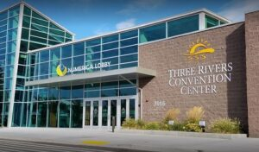
Region IX Symposium and Annual Meetings
October 24-26, 2024

Slide 3
Symposium Schedule
THURSDAY, OCTOBER 24
11:00 - 5:00 REGISTRATION
1:00 - 1:50 WELCOME/LOGISTICS/SCHEDULE OVERVIEW
Mary Binder, Symposium Chair, Eastern Washington VP, Chapter 1192
VP INTRODUCE SYMPOSIUM VENDORS, OTHERS
Steven Roy, Region IX VP
1:50 - 2:00 BREAK/MOVE TO MEETING ROOMS
2:00 - 4:30 INDIVIDUAL STATE MEETINGS; TIME WITH VENDORS
4:30 - 5:00 BREAK
5:00 - 6:30 EVENING SOCIAL/NO-HOST BAR; TIME WITH VENDORS
FRIDAY, OCTOBER 25
8:00 - 9:00 REGISTRATION
9:00 - 9:10 WELCOME/REVIEW LOGISTICS
Mary Binder, Symposium Chair, Eastern Washington VP, Chapter 1192 VP
9:10 - 9:40 NARFE UPDATE
Bill Shackelford, NARFE President
9:40 - 11:00 NARFE LEGISLATIVE & NARFE-PAC UPDATES
John Hatton, NARFE Senior VP, Policy & Programs

Slide 4
Symposium Schedule
(Continued)
FRIDAY, OCTOBER 25
8:00 - 9:00 REGISTRATION
9:00 - 9:10 WELCOME/REVIEW LOGISTICS
Mary Binder, Symposium Chair, Eastern Washington VP, Chapter 1192 VP
9:10 - 9:40 NARFE UPDATE
Bill Shackelford, NARFE President
9:40 - 11:00 NARFE LEGISLATIVE & NARFE-PAC UPDATES
John Hatton, NARFE Senior VP, Policy & Programs
11:00 - 11:10 BREAK
11:10 - 11:45 NARFE MEMBERSHIP UPDATE
Nora McDonald, NARFE Director, Membership Engagement
11:45 - 12:25 WORKING LUNCH W/HEALTHCARE PROVIDERS Qs/As
Ruthann Couch, President, Oregon Federation; Healthcare Representatives
12:25 - 12:35 BREAK
12:35 - 1:20 NARFE COMMUNICATIONS UPDATE
Jennifer Rafael, NARFE Director, Communications & Marketing
1:20 - 1:45 REGION IX UPDATE
Steven Roy, Region IX VP
1:45 - 2:30 FEDERATION PRESIDENTS UPDATES
Federation Presidents for Alaska, Idaho, Montana, Oregon, Washington

Slide 5
Symposium Schedule
(Continued)
FRIDAY, OCTOBER 25
2:30 - 2:45 BREAK
2:45 - 3:30 TRAINING: ACCESSING MEMBER PROFILE
Harold Kehr, Idaho Federation Secretary, SE Area VP, Chapter 763 President
TRAINING: FEDHUB; NARFE WEBSITE & MICROSITES
Linda Wallers, WSF Secretary & Webmaster
3:30 - 3:45 TRAINING: ACCESSING NARFE LEGISLATIVE/PAC INFO
Doug Rushton, WSF Legislative (National) & NARFE-PAC Coordinator
3:45 - 4:00 TRAINING: REPORTING A DEATH
Charlie Caughlan, WSF Service Officer, Chapter 131 VP
4:00 - 4:30 TRAINING OPTION: AMS 101 - MEMBER REPORTS
Harold Kehr, Idaho Federation Secretary, SE Area VP, Chapter 763 President
TRAINING OPTION: NARFE 101 - INFORMATION, Qs/As
Mary Binder, Symposium Chair; Eastern Washington VP; Chapter 1192 VP
4:30 - 4:45 QUESTIONS & ANSWERS; WRAP UP
4:45 CLOSE DAY 2
5:00 - 6:00 SOCIAL TIME; NO-HOST BAR
6:00 - 7:30 BANQUET DINNER & ENTERTAINMENT

Slide 6
Symposium Schedule
(Continued)
SATURDAY, OCTOBER 26
8:30 - 9:00 MEMORIAL SERVICE
Steven Roy, Region IX VP; Federation Presidents; Charlie Caughlan (bagpipes)
9:00 - 9:45 PROGRAM IDEAS FOR CHAPTER MEETINGS
David Epstein, Chapter 2088 President, Juneau (virtual)
9:45 - 10:00 BREAK
10:00 - 10:30 REGION IX & WALK TO END ALZHEIMER’S INFO
Leland (Wally) Walbruch, Past Region IX Alzheimer’s Coordinator
10:30 - 11:00 OUTREACH SUCCESSES & NARFE ELEVATOR SPEECH
Mary Binder, Symposium Chair; Eastern Washington VP; Chapter 1192 VP
11:00 - 11:30 FUTURE SYMPOSIUMS; ANNOUNCEMENTS;
RECAP COMPLETE/COLLECT EVALUATION FORMS
11:30 CLOSE SYMPOSIUM

Slide 7

Annual Meeting 2024

Slide 8
2024 WSF Annual Meeting October 24, 2024
Agenda
TIME
2:00 – 2:20 | Call to Order; Welcome; Pledge of Allegiance, a BRIEF State of the Federation -- Cray Henry
2:20 – 2:25 | Region IX Alzheimer’s Report & Presentation of National Award -- Linda O’Donnell, -- Lorie Bennett
2:20 – 2:40 | WSF 2025/2026 Election Results, and Installations (in advance) of New Officers for 2025/2026 Term Pat Rudd (or Cray if Pat is not available) Steve Roy
2:40 – 3:20 ~3-5 min each | Chapter Presidents’ Reports & Comments Scott Robinson, Spokane Bob Rust, Seattle & Sequim Mike Teefy, Vancouver Bill Powers, Bremerton Marvin Weiss, Everett Tony Merola, Olympia South Puget Sound Tina Hedges/Marnie Berry/Autie Bergman, Longview/Kelso Nancy Crosby, Tri-Cities Elizabeth Parazoo, Colville Valley
3:20 – 3:30 | Break
3:30 - 4:15 ~5-10 each | Federation Advisory Committee Reports & Comments Doug Rushton, Legislative Report WSF PAC Report WSF John Thurber, Legislative Coordinator-State Charlie Caughlan, Service Officer Linda Wallers & Curits Price, WSF Secretary Bylaws and reports status Webmaster Report Mary Traxler & Merry Byrum, Outreach & Strategic Planning Efforts Mary Binder State of Eastern Washington Bea Bull State of Western Washington Arlene Patton, Treasurer’s Report
4:15 – 4:30 | Open Discussion
4:30 | Final Words & Adjournment -Cray Henry

Slide 9
Pledge of Allegiance
I pledge allegiance to the flag of the United States of America and to the Republic for which it stands, one Nation under God, indivisible, with liberty and justice for all

Slide 10

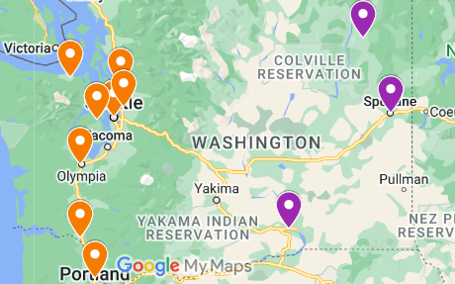
WASHINGTON’S FEDERAL FAMILY
Total Active and Retired
Federal and Postal Employees 141,161
Washington’s Federal Family
Federal Annuitants 72,647
Active Federal Employees 56,411
U.S. Postal Service Employees 12,103
Washington’s Largest Employers
Department of Defense 30,570
United States Postal Service 12,103
Department of Veterans Affairs 10,061
Social Security Administration 2,559
Forest Service 2,272
Bureau of Reclamation & National Park Service (NPS) 2,196
10 Chapters
0032 – Spokane 0043 – Seattle 0131 – Vancouver
0181 – Bremerton 0193 – Everett 0236 – Olympia/South Puget Sound 1006 – Olympic Peninsula/Sequim 1070 – Longview/Kelso 1192 – Tri-Cities 1247 – Colville Valley 1966 – Sno-King
Total of Current Chapter Members in the Federation 1614
Total of all the National Members in the Federation 2153
Total Members 3767

Slide 11
Our Crisis & Focus NARFE is the only organization solely dedicated to protecting and preserving the pay and benefits of all federal workers and retirees.
National Active and Retired Federal Employee Association
Washington State Federation
President Cray Henry

Slide 12
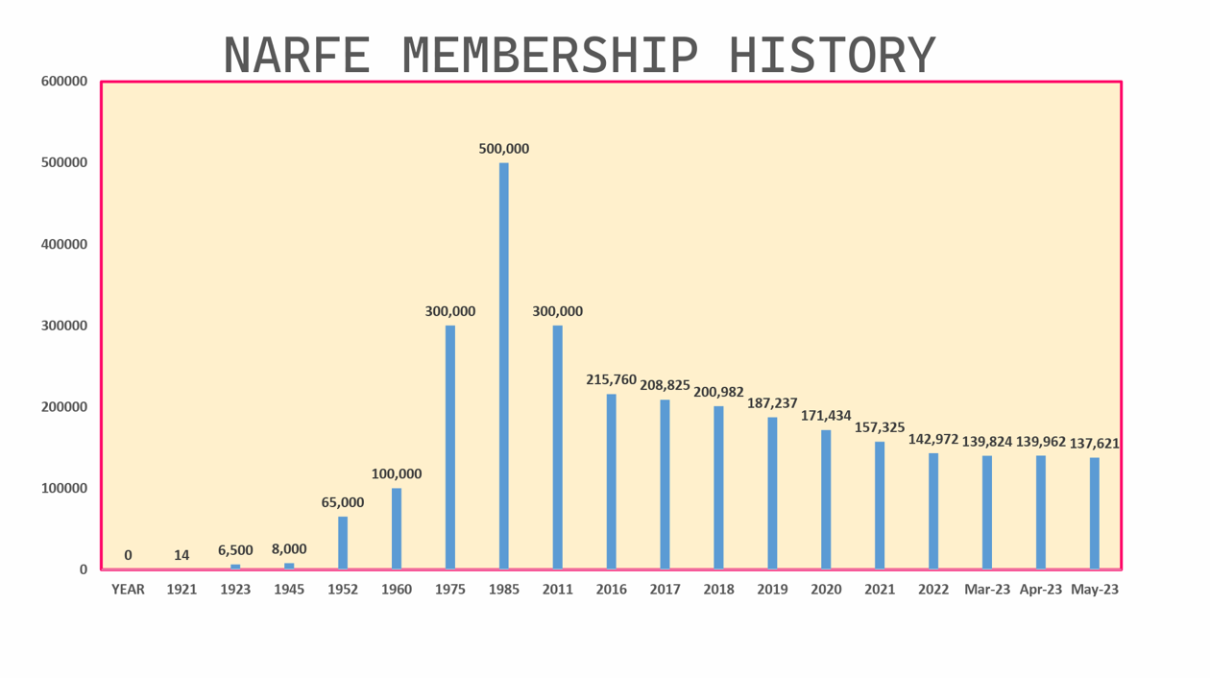
OUR CRISIS -- Membership Decline
From 2011 to 2021 our membership declined by 50% and the trend appears to be accelerating!
As we lose members, we also lose political power and interest.
If the trend continues NARFE will become irrelevant by 2031
Nationally we need to recruit 15,000 new members annually just to hold our current membership levels!
- That means the WSF needs to recruit at least 400 -600 new members annually

Slide 13
NARFE WSF Strategic Goals
Strategic Goal: GROW MEMBERSHIP BY 10% (~400 NEW MEMBERS)
Without a critical mass of members our ability to accomplish our mission comes into question. To defend and advance the earned pay and benefits of America’s civil servants and to promote the general welfare of federal civilian employees and annuitants, we need sufficient members to retain the attention of our congressional representatives and to maintain vibrant chapters.
We need to focus on recruitment, if we want NARFE to continue to serve federal civilian employees and annuitants.
There are four elements to our goal:
-1 Increase membership to a level to sustain and fill elected and chair positions.
-2 Jump start the recruitment effort for each chapter, by focusing each chapter, on Health Fairs as recruitment opportunities.
-3 Expand recruitment efforts, for each chapter, by identifying recruitment opportunities for new members prior to retirement within chapters’ geographic area.
-4 Support recruitment efforts, for each chapter, by designing a formal advertising campaign for each chapters’ geographic location (based on 1-3.3) and targeted audience.

Slide 14
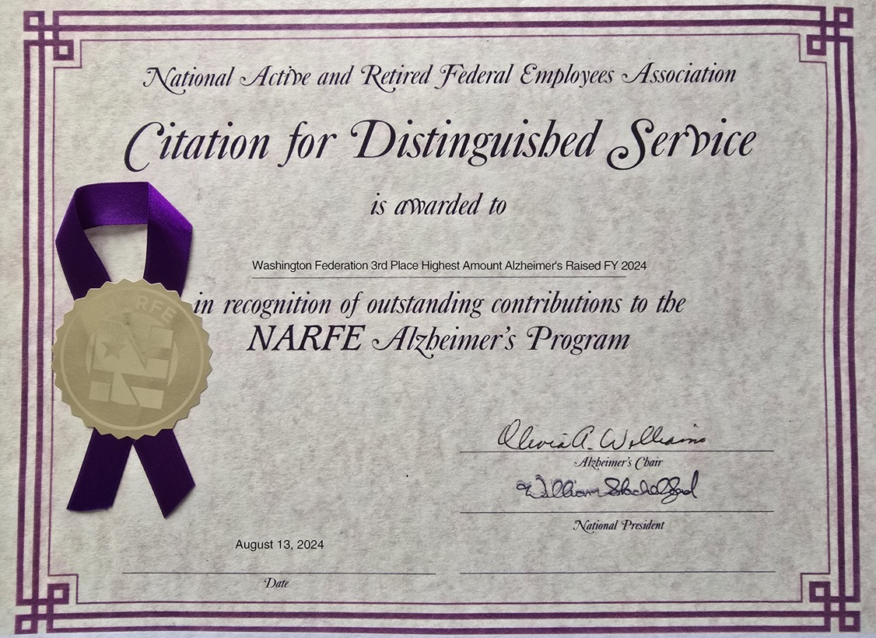
Region IX Alzheimer’s Report & Presentation of National Award

Slide 16
FINAL REPORT OF NOMINATION COMMITTEE
FOR SYMPOSIUM OCTOBER 24-26, 2024
Cray Henry, president of Washington Federation appointed the nominating committee consisting of Patricia Rudd, Linda Wallers and Kathy Brooks. Cray called for nominations for President, Vice-President, Secretary and Treasurer. Nominations were timely received for the following positions:
PRESIDENT Anthony Merola Chapter 236 Olympia-Timberline
VICE PRESIDENT Kathy Brooks. Chapter. 32 Spokane
SECRETARY Curtis Price. Chapter 193 Everett
MANY CONTACTS WERE SUGGESTED FOR THE TREASURER POSITION AND THE COMMITTEE WAS UNABLE TO GET COMMITTMENT FROM FIVE SUGGESTED NAMES.
RECENTLY the current Treasurer , ARLENE PATTON has. agreed to remain in her currently held position as Treasurer until a replacement could be identified.
The nomination committee has vetted these candidates and recommends they are qualified to serve.
Patricia Rudd ,chairman Nominating Committee
Linda Waller
Kathy Brooks

Slide 17
Installation of New Officers
New Officers Elected by Acclamation
Since there was only one nominee/volunteer for each position, at the last Washington State Federation Advisory Committee, Cray made a motion to elect the slate of officers by acclamation; the motion was seconded by Mary B and passed unanimously. The new officers will be installed by Steve at the symposium and begin their term on 1 January 2025 as put forth in the WSF Bylaws
Installation of Officers
Please raise your right hand.
“I hereby pledge to effectively perform the duties of my office; carry out the programs, policies, and bylaws of the Association; promote its goals and objectives; and work as a team in harmony with the Association’s leadership. I will safeguard all of the Association’s property under my care; have such property available for official inspection if required; and pass on said property intact to my successor.”
I hereby declare you duly installed officers of the Washington State Federation of NARFE. You will now assume the duties of your office as prescribed by the bylaws.

Slide 18
Closing Thoughts
There is no NARFE without members -- NARFE will not survive without a strategic focus on recruitment
Chapters need to focus on recruiting Chapter members to grow the pool of potential officers
The National organization needs to focus on recruiting National members
Chapter members and National members have different wants and needs
National members are primarily focused on financially supporting Advocacy
Chapter members are balance focused on community, Federal Benefits support and Advocacy
Chapters are closing primarily because of a lack of new members to take on leadership roles
We will continue to loss chapters if we can’t find a way to recruit new members into chapters
NARFE and the WSF are structed to support lots of members (250,000+ and 10,000+) with associated administrative procedures. Most of the Chapter and Federation officers have held multiple posts for decades.
With the declining number of chapters, its not clear the administrative cost of a Federation is worth the benefit. Consider reworking the WSF by-laws to simplify Federation leadership and administration.
Consider a regional Federation.

Slide 19
Memorial Thoughts
We remember our members, who as civil servants are
our quiet and unsung heroes. They provided for our national security, our day-to-day protection & safety, the protection and care of our national resources, roads, airways, shipping lanes, food and workplaces. They tirelessly served our Nation often in often innovative ways to benefit our people and keeping our Nation strong and prosperous. We remember you and your service.
Region IX
Alaska 12
Idaho 47
Montana 25
Oregon 103
Washington 209

