Slide 1


NARFE-Region IX –
Alzheimer’s and Dementia Community Conversation
An Alzheimer's and Dementia Community Conversation
Notes:
Melanie: Good morning/Good evening! My name is [name]. I am the [describe role].
Welcome to the Alzheimer’s Association Community Forums. We’re so glad that you have joined us today to learn more about Alzheimer’s disease and other dementias. This program is designed for ____________
Before we dive into today’s session, I would like to recognize our community partner and have ____________ share a word. {partner inserts comments about the importance of the Forum}
Jeannie: Thank you for setting the stage for today’s webinar. We are excited to partner with the Alzheimer’s Association to provide this very timely and important information to our communities across the globe. At this time, I would like to introduce our facilitator for today’s session. We are joined by [Presenter’s name, Title and Chapter name and location] [Presenters name] will guide us through today’s webinar. Take it away, [Presenter’s name].
This webinar is designed for people who are caregiving for a person living with dementia or Alzheimer’s, those who are professionals in the healthcare or care industry, and those who may have a casual interest in the disease and want to learn more.

Slide 2
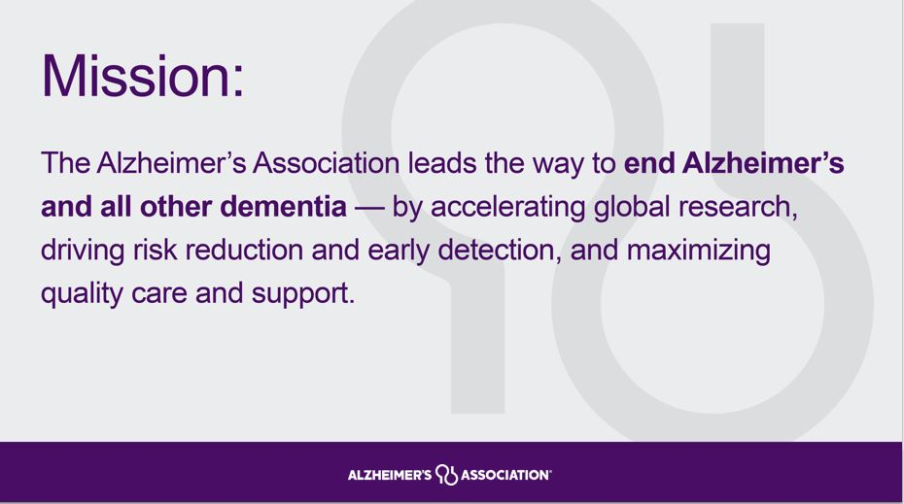
Notes:
As you can see, the numbers are staggering:
•More than 6 million Americans are living with Alzheimer’s
•Over 11 million are providing unpaid care for people living with the disease.
•Alzheimer’s is one of the costliest conditions to society.
•Left unchecked, Alzheimer's will destroy our finances, our families and our futures.
Fortunately, the Alzheimer’s Association is leading the way to end Alzheimer's and all other dementia around the world and in our community.

Slide 3




The Alzheimer's Association leads the way to end Alzheimer's and all other dementia — by accelerating global research, driving risk reduction and early detection, and maximizing quality care and support.
Our dual mission symbol represents the abstract forms of a human head and a beaker, emphasizing the people and the science behind our cause.
Ω
Care
& Support
Advocacy
Education
& Awareness
Research
Diversity, Equity & Inclusion

Slide 4
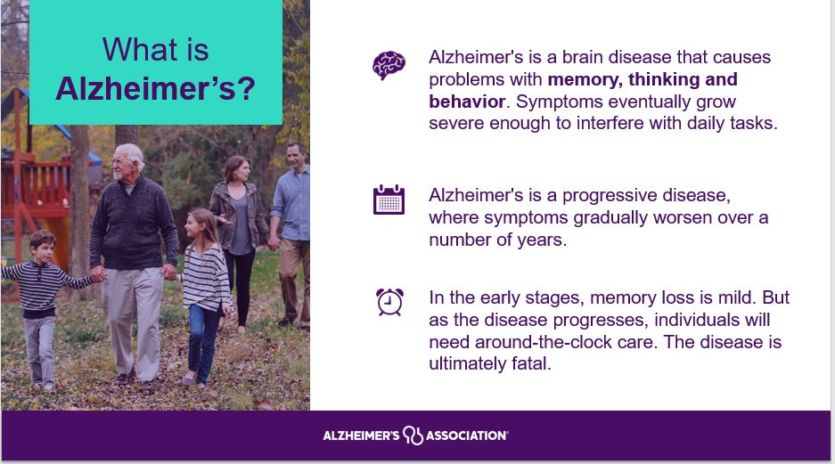
Notes:
Alzheimer's is the most common cause of dementia. It is not a normal part of aging.
The greatest known risk factor for Alzheimer’s is increasing age, and the majority of people with Alzheimer's are 65 and older. Alzheimer’s disease is considered to be younger-onset Alzheimer’s if it affects a person under 65. Younger-onset can also be referred to as early-onset Alzheimer’s. People with younger-onset Alzheimer’s can be in the early, middle or late stage of the disease.
Alzheimer's worsens over time. Alzheimer's is a progressive disease, where dementia symptoms gradually worsen over a number of years. In its early stages, memory loss is mild, but with late-stage Alzheimer's, individuals lose the ability to carry on a conversation and respond to their environment. On average, a person with Alzheimer's lives 4 to 8 years after diagnosis but can live as long as 20 years, depending on other factors.
Often dementia will start out slowly and gradually get worse. If you or someone you know is experiencing memory difficulties or other changes in thinking skills, don't ignore them ~ even if the symptoms are mild. See a doctor soon to determine the cause. There are many benefits to receiving an early and accurate diagnosis, including an opportunity to plan for the future, access support services and explore treatment options.

Slide 5
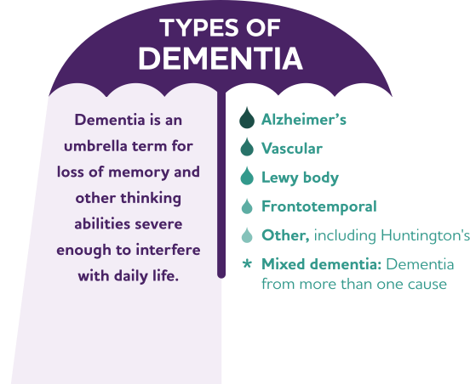
What is Dementia?
Dementia is a collection of symptoms related to cognitive decline
This can include
  Cognitive symptoms
  Behavioral symptoms
  Psychological symptoms
Alzheimer’s is the most common cause of dementia
Not everyone with cognitive decline has dementia. Some causes of cognitive decline are reversible.

Slide 6
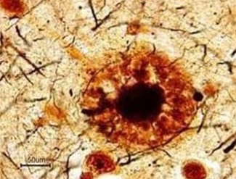
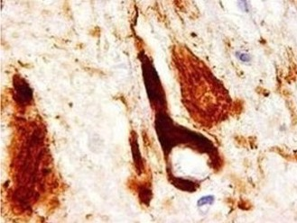
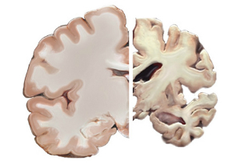
The Hallmarks of Alzheimer’s
Plaques
Tangles
Brain Cell Death
1
Plaques
2
3
Made up of beta amyloid
Made up of tau
Healthy
brain
Advanced
Alzheimer’s

Slide 7


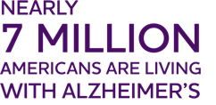
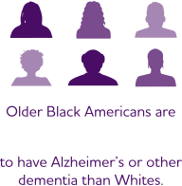
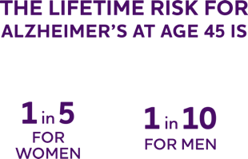


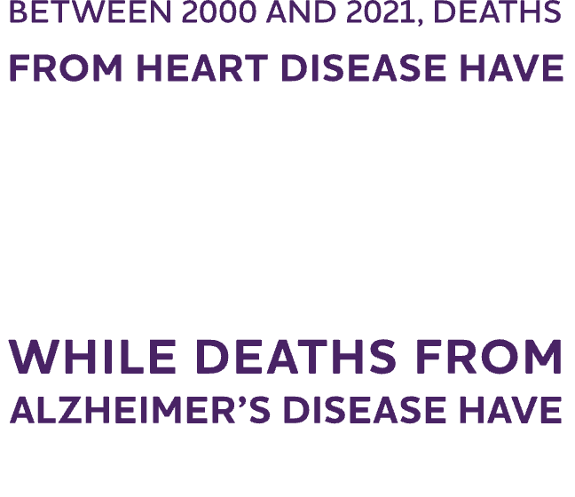
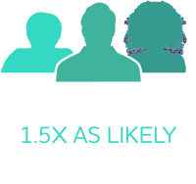




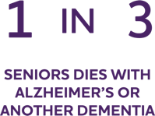

Slide 8

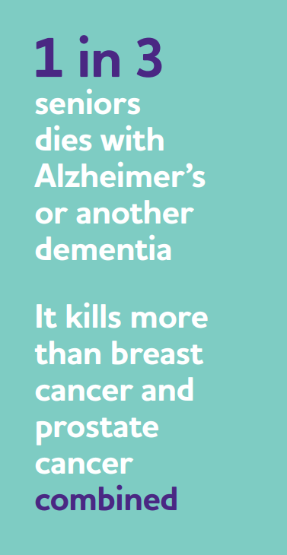
Who is at risk?
Age
Family history
Genetics
Ethnicity/Race
Sex
Head injury?
Lifestyle?
Notes:
(Julie Bushmaker)(When we learn more about dementia, it’s common for people to wonder if they are at risk. So let’s talk about risk factors.
The known risk factors for Alzheimer’s are:
Age: most people who develop the disease are over age 65
Family history: Another strong risk factor is family history. Those who have a parent, brother or sister with Alzheimer’s are more likely to develop the disease
Heredity: Scientists know genes are involved in Alzheimer’s. Two categories of genes influence whether a person develops a disease: risk genes and deterministic genes.
Head injury: There is a link between head injury and future risk of dementia. Protect your brain by buckling your seat belt, wearing your helmet when participating in sports, and “fall-proofing” your home. Learn more about traumatic brain injury.
Heart-head connection: Some of the strongest evidence links brain health to heart health. This connection makes sense, because the brain is nourished by one of the body’s richest networks of blood vessels, and the heart is responsible for pumping blood through these blood vessels to the brain.
The risk of developing Alzheimer’s or vascular dementia appears to be increased by many conditions that damage the heart and blood vessels. These include heart disease, diabetes, stroke, high blood pressure and high cholesterol. Work with your doctor to monitor your heart health and treat any problems that arise.
It is estimated that 1 in 3 seniors dies with Alzheimer’s or another dementia
6th leading cause of death in US. 5th leading cause of death for those age 65 and older AND for women of any age

Slide 9
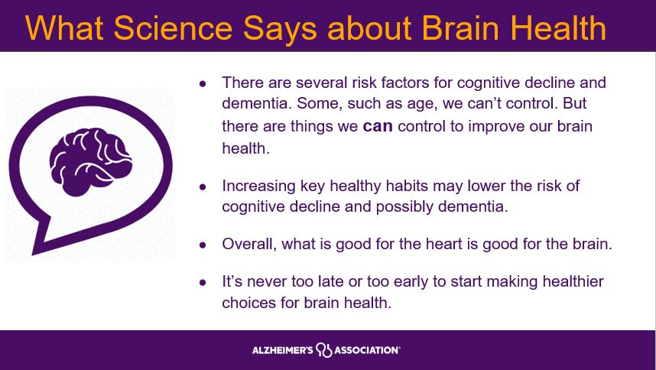
Notes:
In addition to the exciting advancements in treatment, there is more research every day about the importance of brain health to reduce the risk of Alzheimer’s disease and dementia.
There are several risk factors for cognitive decline and dementia. Some, such as age, we can’t control.
Research is still evolving, but evidence is strong that people can reduce their risk of cognitive decline by making key lifestyle changes, including participating in regular physical activity, staying socially engaged, and maintaining good heart health.
When possible, combine these habits to achieve maximum benefit for the brain and body. Start now. It’s never too late or too early to incorporate healthy habits.

Slide 10
Alzheimer’s Disease is a Continuum
Dementia due to Alzheimer’s Disease
Asymptomatic
MCI* due to Alzheimer’s Disease
Mild
Moderate
Severe
No symptoms but biological changes may be occurring in the brain
up to 20 years before symptoms start
Symptoms of cognitive decline appear
Symptoms interfere with some daily activities
Symptoms interfere with many daily activities
Symptoms interfere with most/all daily activities
MCI = Mild Cognitive Impairment is an early stage of memory loss or other cognitive ability loss that may develop into dementia

Slide 11
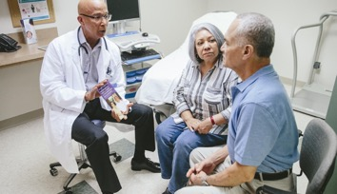





Benefits of an Early and Accurate Diagnosis
Medical Benefits
Emotional and
Social Benefits
Financial Benefits
Access to current treatments
An opportunity to participate in clinical trials
A chance to prioritize health, including making lifestyle changes
More time to plan for the future, access resources
Time to plan end-of-life decisions
Cost savings for families
Cost savings for the U.S. government

Slide 12




How is Alzheimer’s Currently Diagnosed?
There is no single test that can determine if a person is living with Alzheimer’s disease or another dementia.
Doctors use a combination of diagnostic tools combined with medical history to make an accurate diagnosis.
‘
Biomarkers: Imaging & Fluid Analysis
Cognitive Testing
Physical Exam
Neurological
Exam

Slide 13
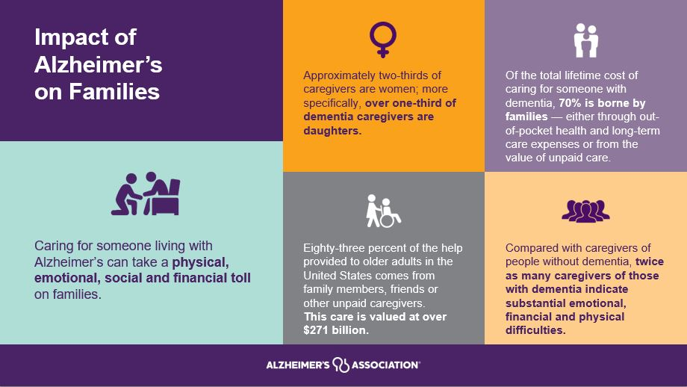
Notes:
Adult children and spouses of people living with dementia often serve as primary caregivers. It can be challenging for all family members to accept changes in their roles and responsibilities.
The demands of caregiving can limit a caregiver's ability to take care of themselves. Family caregivers of people with Alzheimer's and related dementias are at greater risk for anxiety, depression, and poorer quality of life than caregivers of people with other conditions.
Additionally, the lifetime cost of care for individuals with Alzheimer’s is more than twice the amount incurred by individuals without Alzheimer’s.

Slide 14
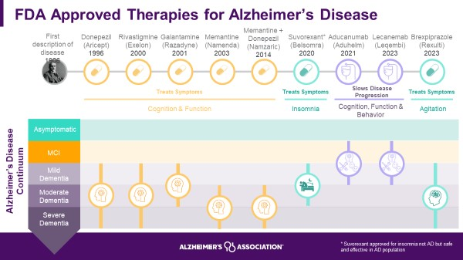
2024 Approved Therapies Timeline

Slide 15
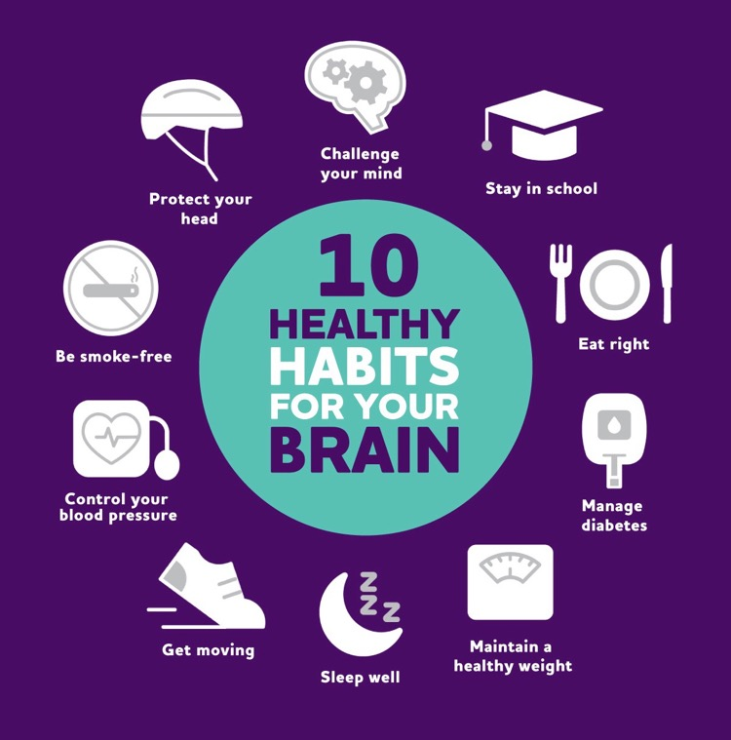
Reducing Risk of Dementia
Positive, everyday actions can make a difference in brain health, even lowering the risk of cognitive decline and possibly Alzheimer's and dementia.
Up to 40% of dementia cases could be prevented or delayed by targeting modifiable risk factors.
Research suggests combining multiple healthy factors may be the most impactful.
Nonmodifiable risk factors include age, genetics and sex/ gender/ race/ ethnicity.

Slide 16


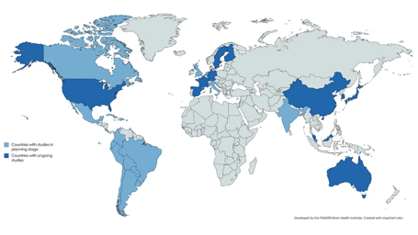

WHAT:
Two-year clinical trial across the U.S.
RESULTS EXPECTED, SUMMER 2025
WHAT:
Global network of lifestyle intervention trials that share experiences, data and joint initiatives to prevent cognitive impairment & dementia worldwide
HOW:
Study intervention simultaneously targets multiple risk factors with a goal to protect cognitive function in older adults at increased risk for cognitive decline.
HOW:
World-Wide FINGERS network now includes research teams in 62 countries
Results from this trial will inform the development of accessible and sustainable community-based programs for dementia prevention.

Slide 17
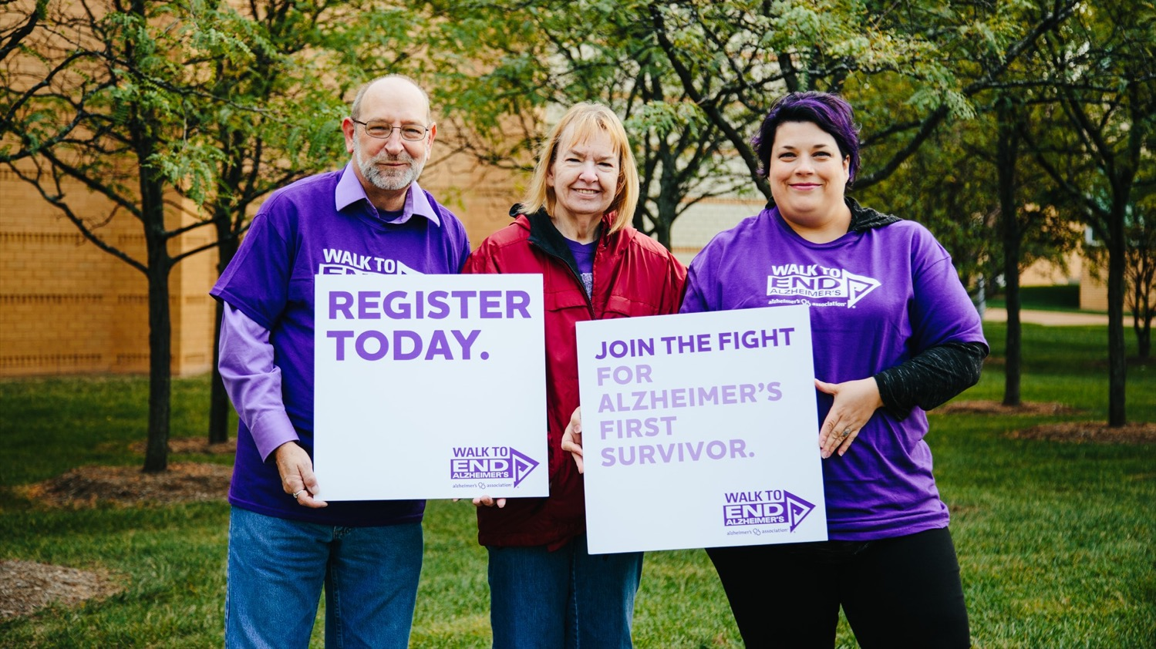

Ways to Join the Fight

Slide 18
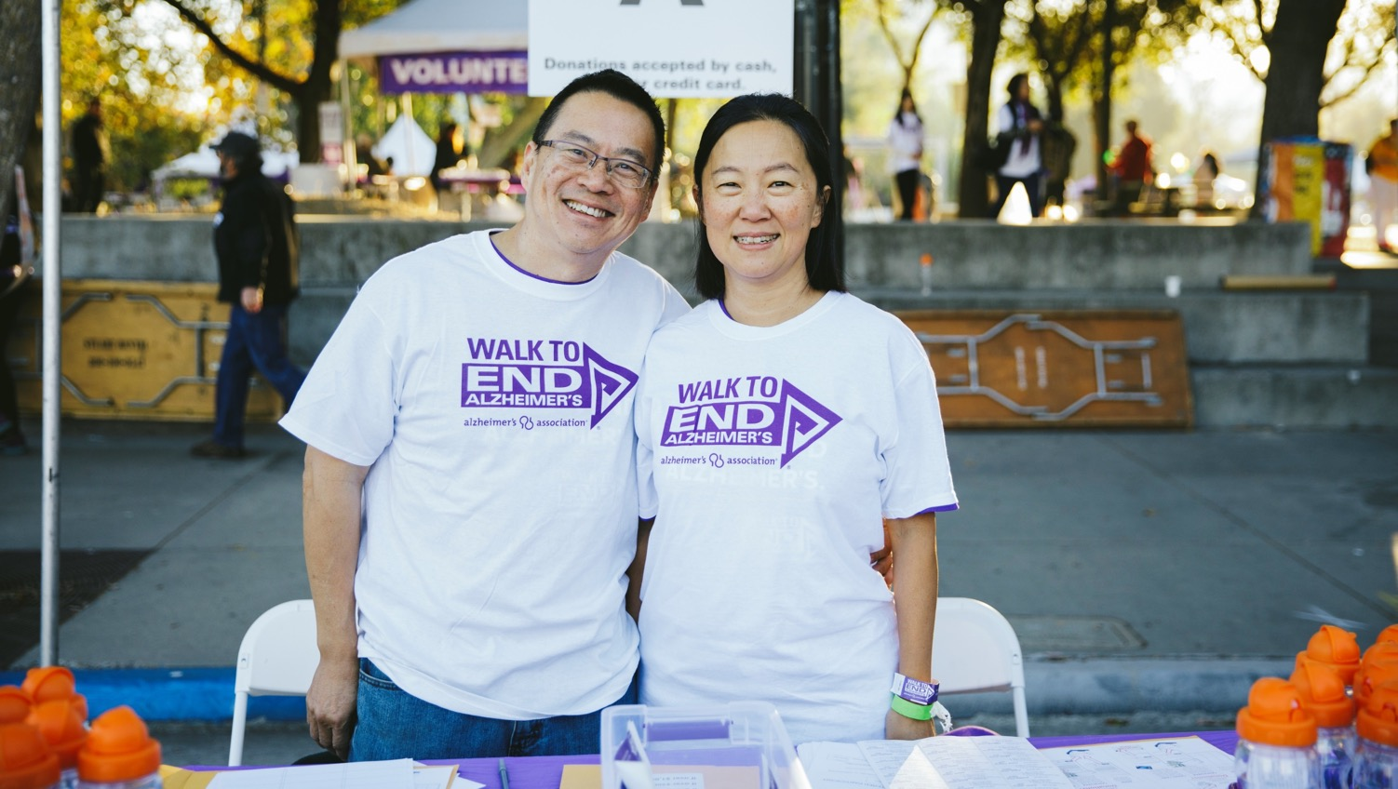


Whether you can spare a few hours a week or make a more significant time commitment, consider volunteering with the Alzheimer's Association. Numerous opportunities are available, including becoming a community educator or joining your local Walk Committee. alz.org/volunteer
In the Flathead Valley, your local volunteers are Wally Walbruch, Jennifer Crowly, and Susan Socha.
Volunteer
Advocacy
TrialMatch®
Walk to End Alzheimer’s®
The Longest Day®

Slide 19
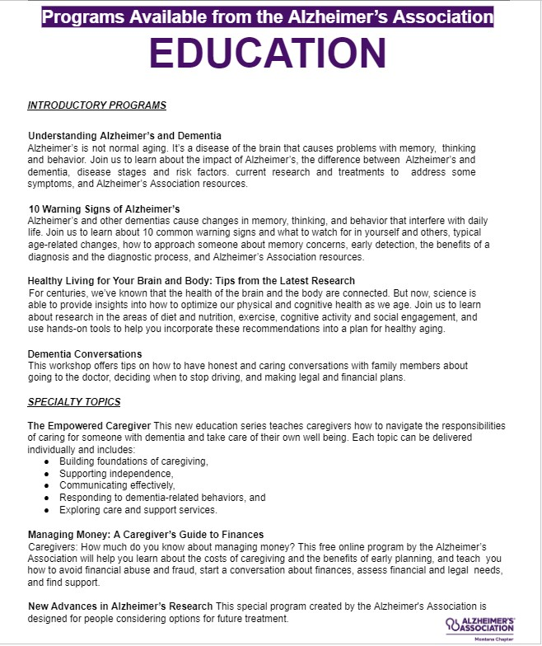
Educational Programs

Slide 20
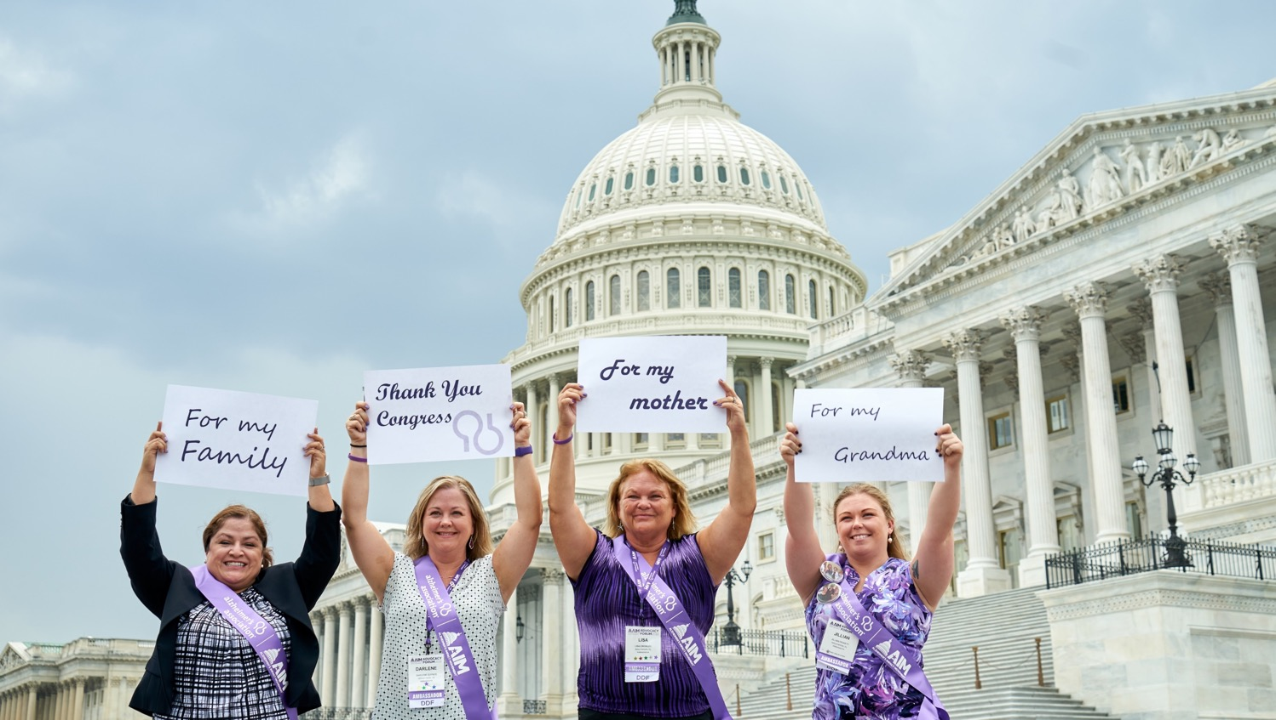
Become an Alzheimer’s Association advocate and speak out on behalf of the needs and rights of those facing Alzheimer’s disease. alzimpact.org
Volunteer
Advocacy
TrialMatch®
Walk to End Alzheimer’s®
The Longest Day®

Slide 21
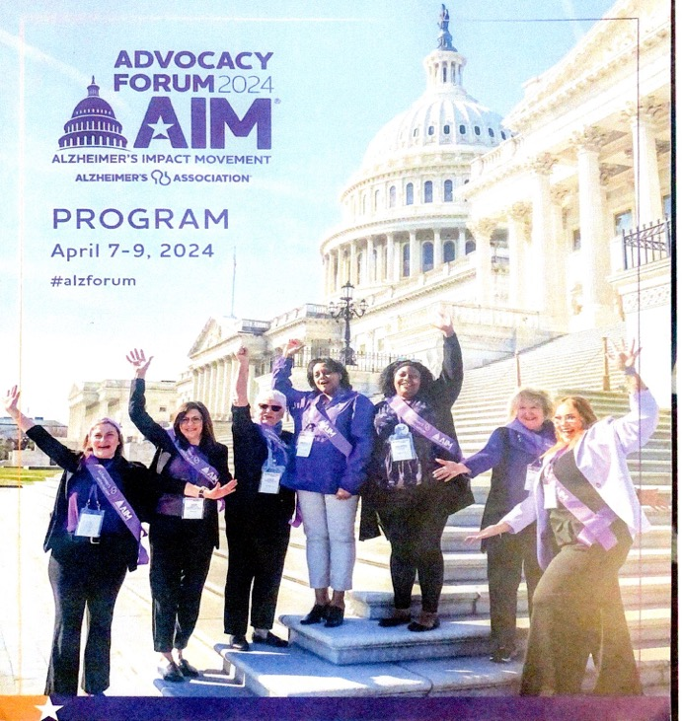
Advocacy
NAPA Reauthorization Bill (S133/H.R.619) Daines Tester
Alzheimer’s Accountability and Investment Act (S134/H.R.620)
BOLD Infrastructure for Alzheimer’s Reauthorization Act
(H.R.7218/S3775) Montana CDC
Accelerating Access to Dementia and Alzheimer’s Provider Training (AADAP) Act (H.R.7688) Rural Montana Training
FY25 Appropriations Research

Slide 22
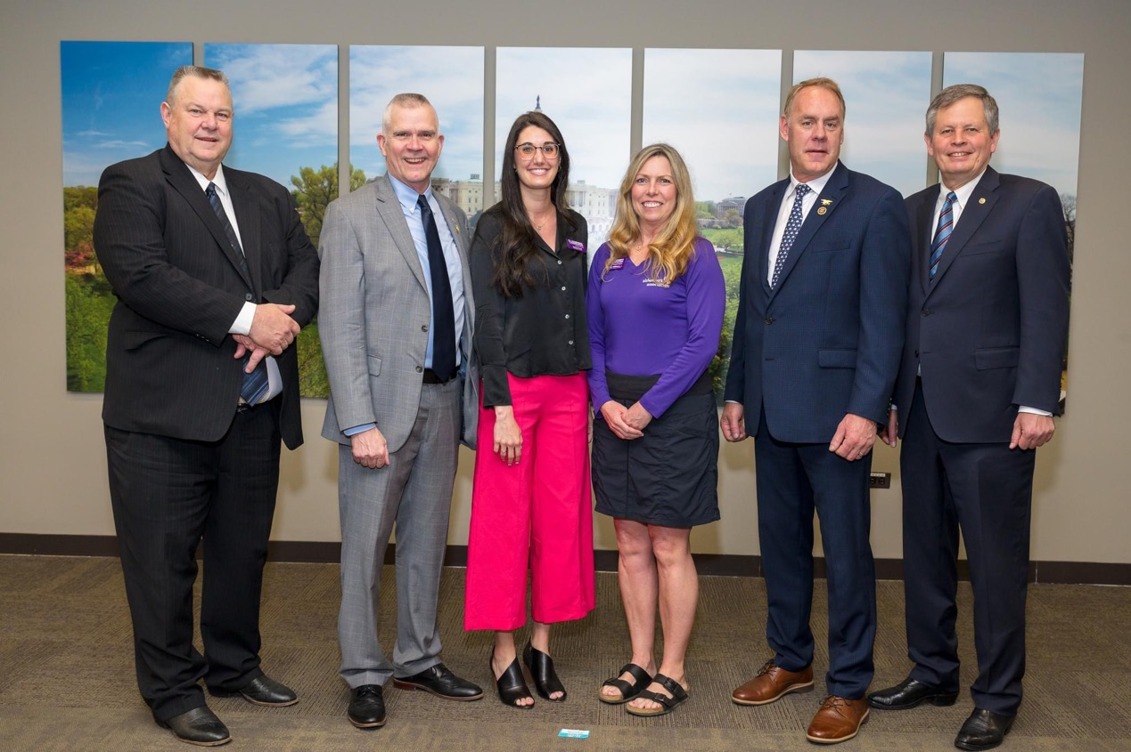

Slide 23


Everyone can help advance Alzheimer’s research by participating in clinical trials. Get started with Alzheimer’s Association TrialMatch, a free, easy-to-use clinical studies matching service. alz.org/TrialMatch
Volunteer
Advocacy
TrialMatch®
Walk to End Alzheimer’s®
The Longest Day®

Slide 24
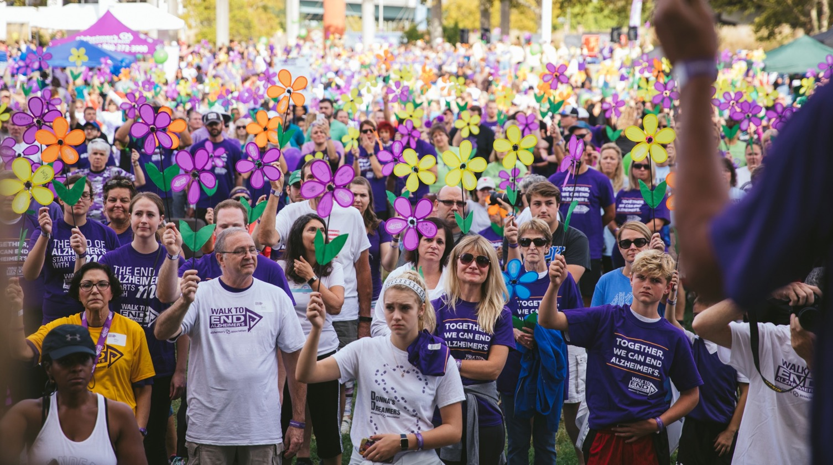
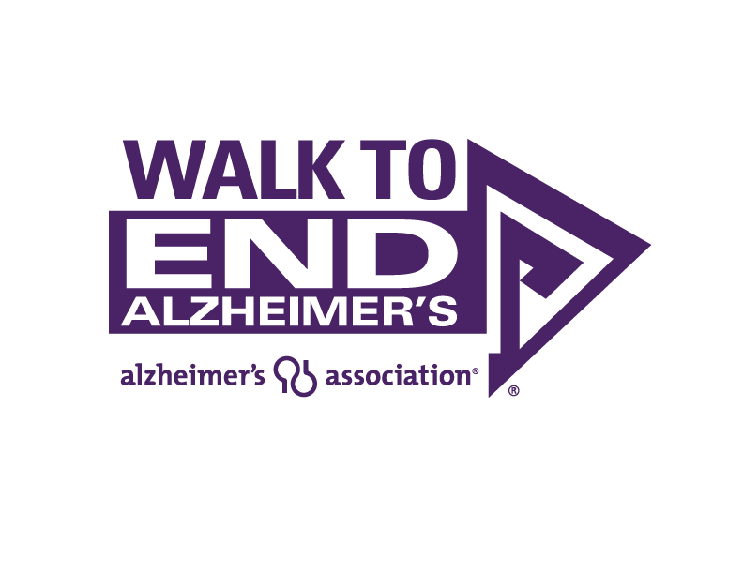
Held annually in more than 600 communities, the Alzheimer's Association Walk to End Alzheimer's is the world's largest fundraiser to fight the disease. Register today to raise awareness and funds to benefit Alzheimer's care, support and research. alz.org/walk.
September 5-The Springs in Butte.
Volunteer
Advocacy
TrialMatch®
Walk to End Alzheimer’s®
The Longest Day®

Slide 25
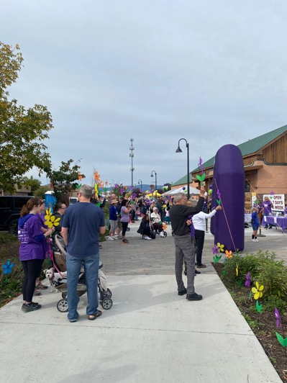
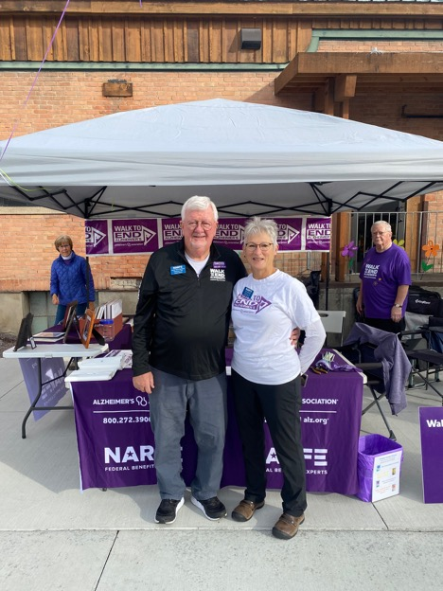
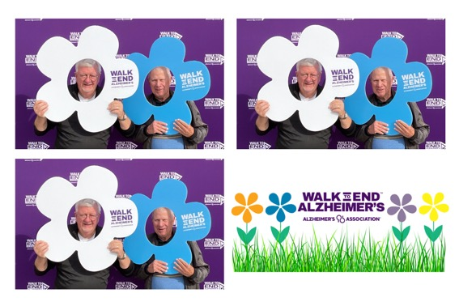
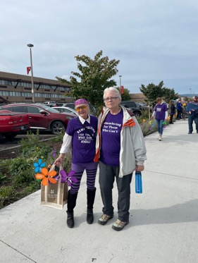
There are 6 Walks in Montana or you could do your own neighborhood walk.

Slide 26

On The Longest Day — June 20th, the day with the most light, the summer solstice — raise funds and awareness for the care, support and research efforts of the Alzheimer’s Association through an activity of your choice. alz.org/thelongestday
Volunteer
Advocacy
TrialMatch®
Walk to End Alzheimer’s®
The Longest Day®

Slide 27


Slide 28
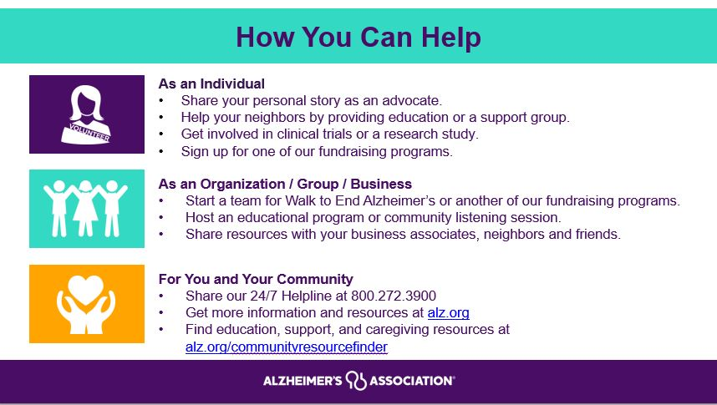
Notes:
You can help us realize our vision of a world without Alzheimer’s and all other dementia. The Association has a variety of volunteer opportunities available to fit all interests, skills, and experience levels.
You can use your unique talents to make a meaningful impact in your community while connecting with others who share your passion. Whether you want to get involved as an individual, volunteer with your service club, organization, company or group, or you need some support for a family, friend or neighbor, the Alzheimer’s Association is here for you. Contact the Alzheimer’s Association to find the role that’s the best fit for you.

Slide 29
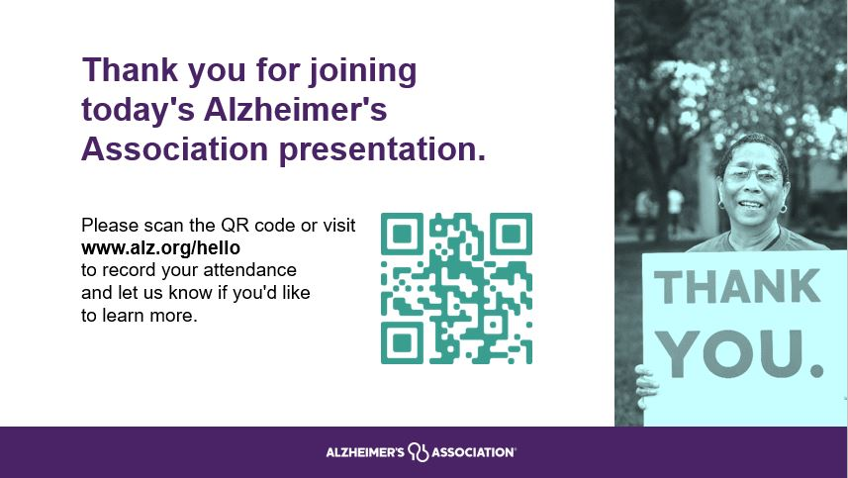
Notes:
Thank you again for attending. Just a reminder to scan the QR code or visit A-L-Z dot org backslash hello to record your attendance at today's presentation.

