Slide 1
Tennessee Federation 2025 – 2026 President’s Report
Notes:
It has been another busy year for the Tennessee Federation! And I must begin my comments by thanking the members of the TN Federation Board– not only the officers but ALL the Board members for their support and their dedication to NARFE and this Federation. These are ALL volunteer jobs, but many times during the year they almost turn into full time jobs.
OKAY. . . ..so what did we ACCOMPLISH since we were all together a year ago?

Slide 2
Activities & Accomplishments
Evaluated 2025 Federation Annual Meeting
Began search for new meeting location
Worked with Chapter 0324 John Sevier; assisted with closure
Attended/participated in Federation Presidents Mtg & NEB Mtg
Formulated plans for ad venture with KY Federation via Street Level Studio
Prepared/submitted Matching Funds Grant to Headquarters for venture
Notes:
Believe it or not. . . .immediately following the Federation Annual Mtg, we begin evaluating what we did well, what might be improved and where we go from here.
We quickly identified that we needed to search for a new meeting location as last year’s meeting room was too small. . . .that was a good thing which means that the Federation Annual Meetings HOPEFULLY is beginning to regain some of its meeting size since the pandemic. Our thanks to Norris for heading up this project and leading us to this location.
Analyzing the Fed Annual Meeting attendance—in ADDITION TO some other LACK OF PARTICIPATION--revealed that we had been missing several Chapters for several years. So, it was time to do some addition research to see what might be going on. It quickly became apparent that Chapter 0324 in east TN was in trouble. I began working with them to seem if we could revive the Chapter since it had not met since before the pandemic. In July, a small group met and the hard decision was made to close as we were not able to establish leadership for them to continue.
In August I represented TN at the Federation Presidents Mtg and their joint in-person meeting the National Executive Board in Indianapolis at the hotel where this year’s FedCON’26 will be meeting. These are always very helpful and informative sessions and I shared a lot about what was going on with NARFE in the newsletters and fact sheets following that session.
It was at that meeting that KY President Steve Saylor and I talked about a potential joint venture to work with SLS to try and get NARFE’s name and brand out to more of our federal agencies within out two states. This venture was also shared in newsletters this past year.
I headed up the preparation and submitting of a Matching Funds Grant from Headquarters. Each state spent $4500 dollars, TN received $2250 back from Headquarters for our efforts

Slide 3
Activities & Accomplishments
TN/KY Joint Venture -- Street Level Studio
Duration: Open Season October 15 to December 15
Focus: Primarily federal agencies; working individuals
Technique: Geofencing / Geotargeting (1-mile radius)
Ads: (designed by SLS) Meta and Google
Impressions: M = 182,417 G = 2,008 Considered successful
24 joined (button clicks) 30 reported by Headquarters
Should TN repeat this venture during 2026 Open Season?
Notes:
Here is a brief summary:
It took place during Open Season which was believed to be the optimal time when federal workers might be thinking about their benefits and possibly more interested in hearing about NARFE.
The focus was predominately working individuals, but KY had asked that it be target retirees in and around the northern KY area.
We were told about and introduced to “geofencing and geotargeting” which encompassed a one-mile radius of these targeted federal agencies. These were specially designed advertisements about NARFE that were featured on Meta and Google.
Street Level was “very pleased” with the outcome. I am not sure if Steve or I actually had realistic expectations. Headquarters reported 30 persons joined as a results.
There is a new pot of money from Headquarters for this year. . .Should we try again to see what might happen this year?
I have been told that on AVERAGE, it takes 14 times for something to be presented to us before we TAKE ACTION.
My question to you: Should we (TN) try again this fall to see if we can get new members?

Slide 4
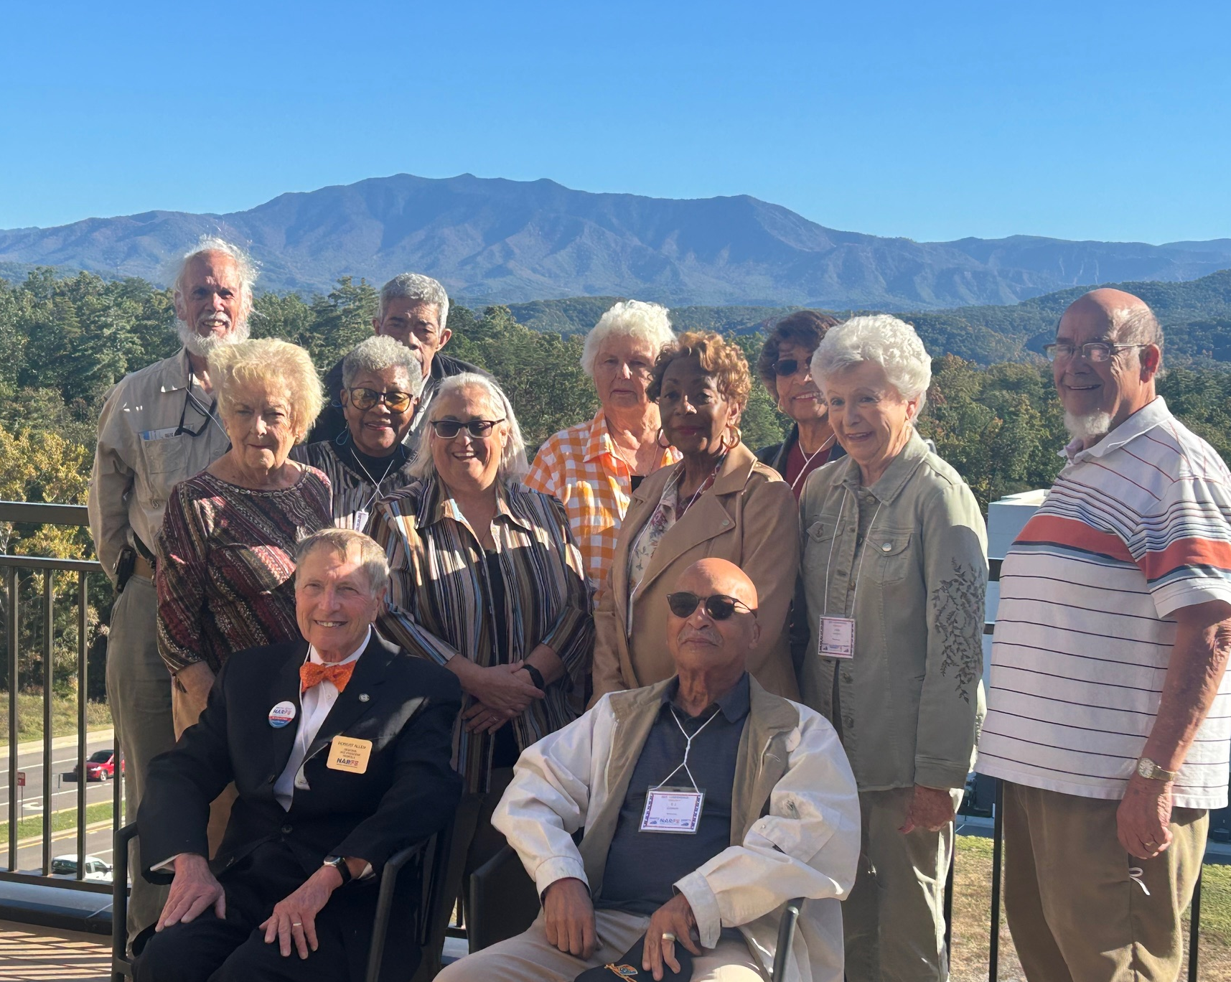
Activities & Accomplishments
Region X Conference - Pigeon Forge
October 21 – 23, 2026 Staybridge Suites
TN host; Region meets alternate years
70 attendees from 5 states
Keynote Speaker – Cindy R. Blythe
Education, Fellowship, Entertainment
Good representation from TN
Notes:
In October our attention turned to the Region X Conference which TN was the state host. We learned this at the 2023 Conference in Frankfort KY, so we had been working some on it for the past two years. BUT now it was time for the rubber to hit the road so to speak.
Of course, RVP Robert Allen was in charge of the event, but TN did all the local leg-work and planning (the exception being the actual meeting schedule). A huge thanks and appreciation to Chapter 1678 for all their help and assistance—especially Imeda & Randy Wegerth, Bob Wightman, and Glenda Huff.
Evaluations indicated it was a very successful event and TN received LOTS of compliments and accolades!
This is a picture of our TN delegations, but we are missing at least a couple of people here who missed the photo op.

Slide 5

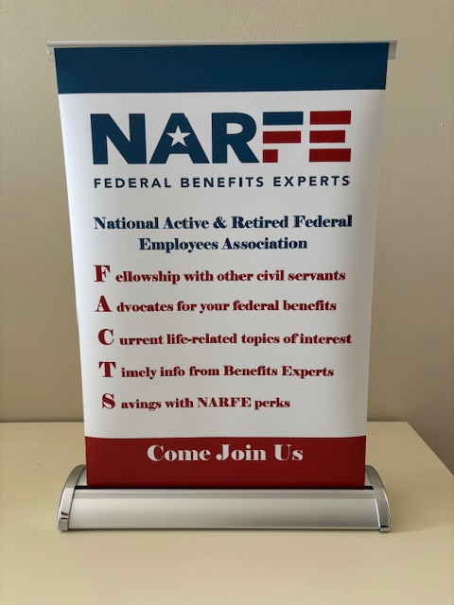

Activities & Accomplishments
Participated in 2 Health Fairs
Promotional Print Material
2 Tabletop Exhibits
2 Table Covers
Notes:
In November, TN was invited by BCBS of TN to have a table at their two Health Fairs—one in Memphis and one in Nashville.
THIS-- as well as well as the KY/TN Membership venture prompted us to work on some promotional materials.
Here are three of our items. Postcard on your left; a tabletop exhibit in the center.
THESE ARE available for Chapters and as well National Only members to use to help is promote and recruit NARFE members.
Mike Mellish has a set of these items and I have the other. Just request them and they can be sent to you for your use.

Slide 6
Activities & Accomplishments
Chapter Visits -- Officer installations
Monthly Region X Federation Presidents Zoom calls
TN Federation Chapter Presidents Chats via Zoom
Communications via “Keeping You in the Loop” with National Only
Quarterly Zoom Meetings Federation Presidents
Federation Annual Meeting planning
Failure to fill Legislative Officer position
Notes:
AND, there are a number of other things we actually accomplished this year as well. A few are listed here:
One of the failures/or lack of accomplishments, has been not filling the Legislative Officer position. BUT we will continue to try! I ask each of you to help me and the Federation Board with this endeavor this coming year!

Slide 7
Thank you! For you for your ongoing support and encouragement this past year.
Linda M. Heaton, TN Federation President
Notes:
Once again my sincere thanks to the entire Federation Board—offices and non-voting members for their help and assistance.
Thanks to you as members for your ongoing support and encouragement.

