Slide 1




Supporting
Brain Health in
Our Community
www.alz.org/hello
Notes:
It’s truly an honor to be here with you today. Thank you for giving me the chance to speak about something that is so important to me — taking care of our brain health and helping protect ourselves from alzheimer’s and dementia. My name is ________, and I’m a proud volunteer with the Alzheimer’s Association.
I volunteer because …
{Insert your story here—whether it’s a loved one’s journey, a personal experience, or a moment that changed your perspective. Speak from the heart. The more real and vulnerable you are, the more your audience will feel it.}
Every time I share this message, I am encouraged to know that there are actions we can take to help us live healthier today and protect our memory and thinking.

Slide 2
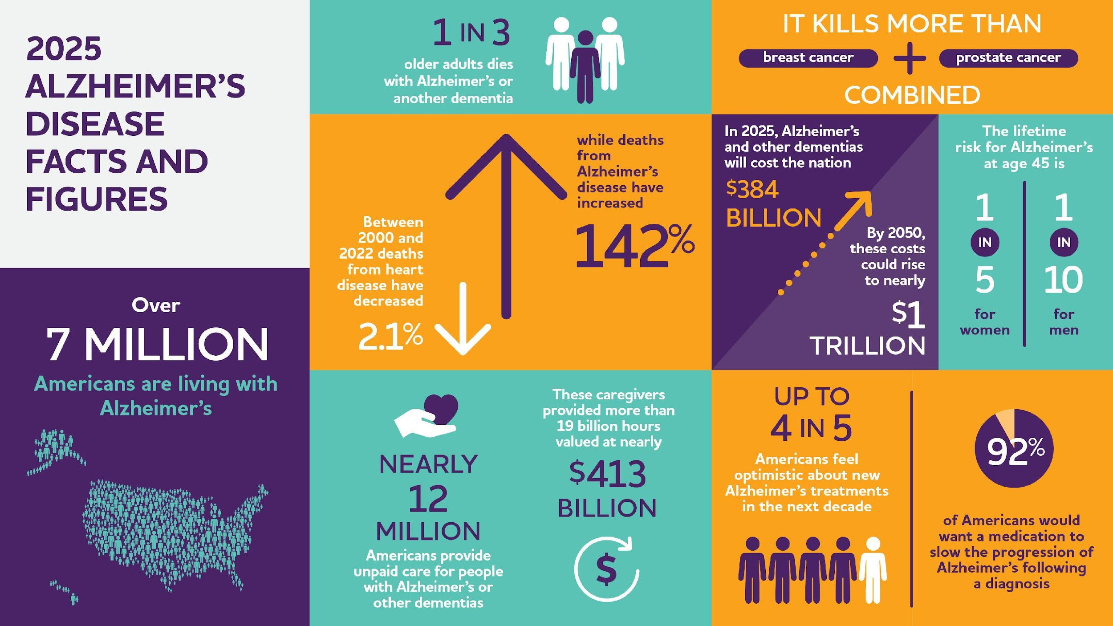
Notes:
Show of hands: How many of you know someone who has been diagnosed with Alzheimer’s disease or dementia?
Let’s just take a moment to look around the room and consider how widespread the impact of Alzheimer’s and dementia can be.
In our {family / organization / community / company / faith community}, Alzheimer’s and dementia have affected many of us, and worldwide the numbers are staggering. PAYING ATTENTION TO BRAIN HEALTH AND ANY CHANGES WE MIGHT NOTICE IN OUR OR OTHER’S THINKING OR MEMORY IS REALLY IMPORTANT.

Slide 3


About the Alzheimer's Association
The Alzheimer’s Association leads the way to end Alzheimer’s and all other dementia — by accelerating global research, driving risk reduction and early detection, and maximizing quality care and support.
Our vision is a world without Alzheimer’s and all other dementia®.
Notes:
The numbers are overwhelming because behind every statistic is a real person, a real family, a real story. Over 7 million Americans are living with Alzheimer’s today. That’s 7 million lives forever changed.
And nearly 12 million people — spouses, children, friends are providing care, not for a paycheck, but out of love. They give their time, their energy, and often their own health and well-being.
Alzheimer’s isn’t just a disease of memory, it’s a disease that steals futures. It’s one of the most expensive conditions in our society, draining families emotionally and financially. If we don’t act, the toll will only continue to grow on our healthcare system and our communities.
My hope is that you leave today not just informed, but inspired. Inspired to share what you’ve learned. INSPIRED TO TAKE ACTION ACTION FOR YOUR BRAIN HEALTH. Inspired to support someone who’s struggling. Inspired to stand with us in this fight—for a world without Alzheimer’s and all other dementia.
Because together, we can change the future.

Slide 4

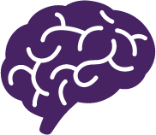

Cognitive Decline
Dementia
Cognitive decline refers to changes in memory, thinking, and/or reasoning that are worsening over time.
An umbrella term for loss of memory and other thinking abilities severe enough to interfere with daily life. Dementia is NOT a normal part of aging.
Alzheimer’s
Vascular
Lewy body
Frontotemporal
Other, including Huntington’s
Mixed dementia: from more than one cause
Notes:
Let’s take a moment to make sure we’re all grounded in what we mean when we talk about cognitive decline and dementia - which is what most of the studies on brain health focus on.
Cognitive decline refers to changes in memory, thinking, and/or reasoning that are worsening over time. Just as with our physical abilities, some cognitive decline is expected as we age. Not everyone with cognitive decline has dementia. Some causes of cognitive decline are reversible.
Dementia is not a single disease. It’s an umbrella term, like heart disease, that covers a wide range of conditions that affect memory, thinking, language, problem-solving and even personality. These changes are serious enough to interfere with daily life and independence. They don’t just affect the person living with dementia they ripple out to families, relationships and entire communities. Alzheimer’s is the most common cause of dementia but there are other causes too.
Dementia IS NOT a normal part of aging.

Slide 5

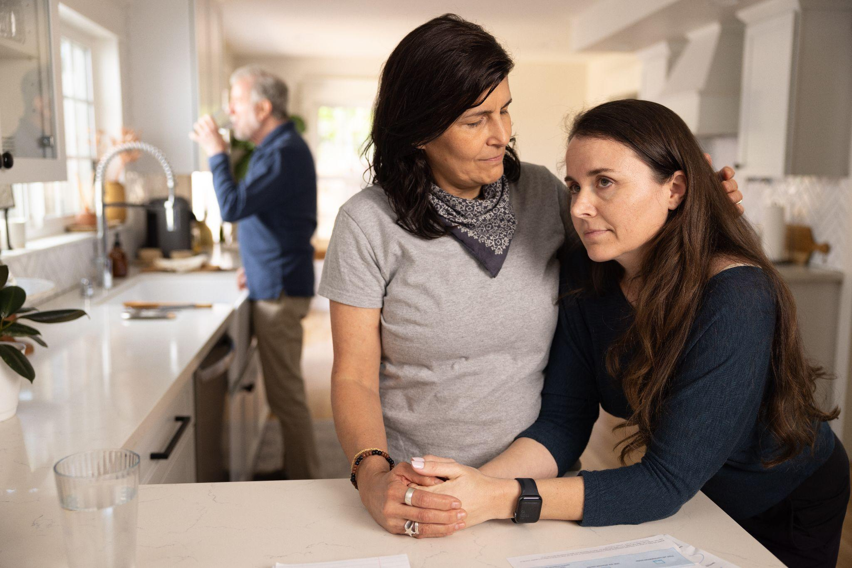

Early detection is important, pay attention to any changes in memory, thinking or behavior that you notice in yourself or someone else.
Early Detection and Treatment
There are treatments that can change disease progression, and drug and non-drug options that may help treat symptoms. Talk to your doctor to learn more about treatment options.
Notes:
When concerns about memory or cognitive changes arise early detection is so important. Early detection isn’t just medical, it’s deeply personal. It’s about giving people the best chance to live fully, with dignity and support.
When Alzheimer’s is caught early, there’s a chance to make lifestyle changes that may help protect brain health, things like managing blood pressure, quitting smoking, staying physically active, and keeping the mind and heart engaged through social and mental activities. It’s not just about medication.
Getting an early diagnosis can also bring peace of mind. It helps explain what’s happening and gives families the chance to plan, connect, and make the most of their time together. It also opens the door to support programs, resources, and a community that understands what you’re going through. Make an appointment with a doctor if you have concerns about yourself or someone you care about.
There is real hope on the horizon. For the first time, we’re seeing treatments that can do more than manage symptoms — they’re actually changing the course of Alzheimer’s disease.
The U.S. Food and Drug Administration (FDA) has approved several medications that fall into two key categories:
Drugs that temporarily ease symptoms like memory loss and confusion.
Anti-amyloid drugs that target the disease by removing beta-amyloid from the brain. Clinical trial participants who received anti-amyloid treatments experienced reduction in cognitive and functional decline, meaning these treatments slowed disease progression.
The anti-amyloid treatments that have been shown to slow disease progression are appropriate for people with
Mild cognitive impairment or mild dementia stage of Alzheimer’s disease AND who ALSO have evidence of a buildup of amyloid plaques in the brain, this is one of the reasons why early detection is important.
These new treatments are pivotal, though not a cure. Today, there is a worldwide effort underway to find better ways to treat the disease, delay its onset and prevent it from developing.
When it comes to any treatment, it’s important to talk with a healthcare provider. They can help you decide if a medication is the right choice and explain the possible benefits and risks.
If someone starts a treatment for Alzheimer’s, they should be monitored by a doctor who knows how to use these medications. That way, they can get the right support and make informed decisions about their care. Also, to avoid side effects or drug interactions, it’s really important that the doctor, pharmacist, and care team know about all the medications being taken, including over-the-counter drugs, vitamins, and herbal supplements.

Slide 6





We all deserve a life with the healthiest brain possible.
We can all take actions to help protect our brain health.
Notes:
The Association believes that everyone deserves to live their life with the healthiest brain possible.
When we talk about promoting brain health and protecting memory and thinking - these messages are for everyone, all ages, all communities– we want to promote them far and wide and turn messages into action. We all live in different circumstances - where we live, our abilities, competing priorities, resources - and this affects our everyday living but I’m confident we can all do SOMETHING for our brain health.

Slide 7

Risks to Brain Health
In most cases, Alzheimer’s is the result of complex interactions across multiple factors.
Non-modifiable Ones we cannot change
Age
Genetics
Family history
Modifiable
Ones we can change!
Certain health conditions
Health behaviors
Notes:
There are many risks to brain health. Some like age, we can’t control. But there are actions we can take to help improve our brain health. Controlling certain health conditions and building more healthy living habits can make a difference. This is true even for people with a family history of dementia.
Every step we take toward healthier living is a step toward a healthier brain.

Slide 8
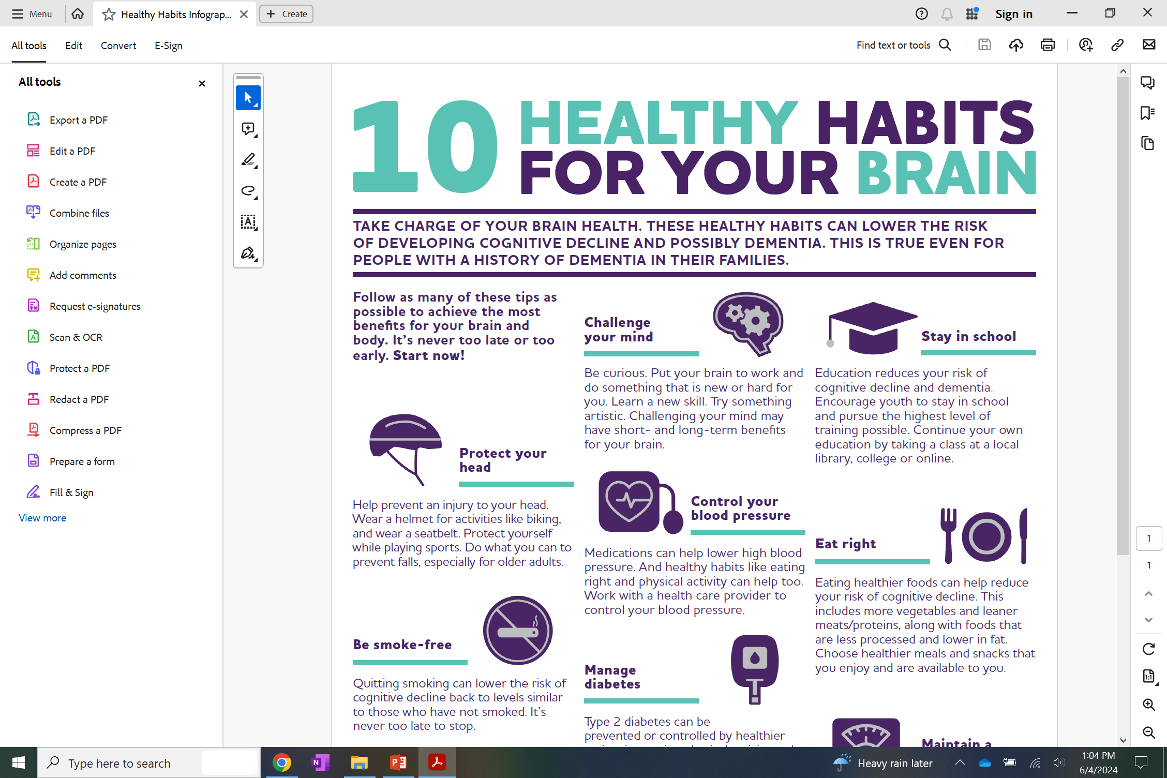




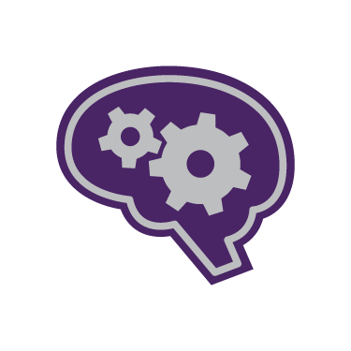





Protect your head
Be smoke-free
Get moving
Challenge your mind
Control your blood pressure
Manage diabetes
Sleep well
Stay in school
Eat right
Maintain a healthy weight
8
Notes:
Here are 10 Healthy Habits for Your Brain.
What’s good for the heart is good for the brain! Many of these habits like eating right and getting moving, can also reduce the risk of heart disease, stroke, and some cancers.
Brain health is important at ALL ages and stages. From childhood through older age, it’s never too early or too late to take action for brain health. Taking care of your brain health can help you feel better now and help protect your memory and thinking when you are older. Many of these habits have ripple effects on others (like exercise can help us sleep better and help control diabetes and blood pressure), and the more habits, the more benefits for brain health.
So let’s take a closer look.

Slide 9


Control Your Blood Pressure
Medications can help lower high blood pressure. And healthy habits like eating right and physical activity can help too. Work with a health care provider to control your blood pressure.
Manage Diabetes
Type 2 diabetes can be prevented or controlled by healthier eating, increasing physical activity, and medication, if necessary.
9
Notes:
NOTE: THE CONTENT ON SCREEN IS THE MESSAGING INCLUDED ON THE ONE-PAGER. IT SHOULD NOT BE READ BUT USE THE TALKING POINTS BELOW.
Hypertension and diabetes are risks to brain health. It’s important for people to monitor both and work with a health care provider to keep them controlled or prevented. For both, medications can be very effective, and other healthy habits, like healthy eating, being physically active, and getting quality sleep can help too.
For blood pressure in particular, there is gold standard evidence, obtained in randomized control trials of diverse populations, that treating high blood pressure is a pathway to reducing cognitive impairment. Systolic blood pressure (the top number) should be under 130 mmHG. Having high blood pressure might not have any obvious symptoms, so people might not be aware their blood pressure is high.. It’s important know your numbers and take any needed action to control them.

Slide 10

Get Moving
Engage in regular physical activity. This includes activities that raise your heart rate and increase blood flow to the brain and body. Find ways to build more movement into your day - walking, dancing, gardening - whatever works for you!
Eat Right
Eating healthier foods can help reduce your risk of cognitive decline. This includes more vegetables and leaner meats/proteins, along with foods that are less processed and lower in fat. Choose healthier meals and snacks that you enjoy and are available to you.
10
Notes:
We all know that physical activity and balanced nutrition are good for overall health – and this includes our brains. Eating right and exercise can have a positive effect on the volume/size our our brains.
Get Moving - Building more movement into your day - especially aerobic or cardio activity - is key. Find what works for you - going for a swim, getting off the train a stop further away and walking the rest of the way, dancing with your kids.
Eat Right - And we know balanced, healthy eating is good for the brain. This includes key themes from well-known healthy diets like the MIND Diet, Mediterranean Diet, and DASH Diet, such as eating lower fat and less processed foods; and more vegetables and lean proteins. Swapping in some healthier options or how you cook - like using olive oil instead of butter - can help you still enjoy your favorite foods, or foods that are important to your culture/family, but in a little bit healthier way.

Slide 11

Maintain A Healthy Weight
Talk to your health care provider about the weight that is healthy for you. Other healthy habits on this list - eating right, physical activity and sleep - can help with maintaining a healthy weight.
Sleep Well
Good quality sleep is important for brain health. Stay off screens before bed and make your sleep space as comfortable as possible. Do all you can to minimize disruptions. If you have any sleep-related problems, such as sleep apnea, talk to a health care provider.
11
Notes:
Maintain a Healthy Weight –
Healthy weight is connected to a lot of the habits we’ve seen already. Midlife obesity is a risk to brain health. So maintaining a healthy weight earlier in life and throughout adulthood is important. Weight is complex and should be discussed with a health care provider to see what is best for you.
Sleep Well –
This is about getting good quality sleep regularly. There are things we might be able to control, like creating the best sleep environment possible for ourselves. But sleep-related problems, like sleep apnea, can affect brain health and these need to be addressed with a health care provider.

Slide 12

Be Smoke-Free
Quitting smoking can lower the risk of cognitive decline back to levels similar to those who have not smoked. It’s never too late to stop.
Protect Your Head
Help prevent an injury to your head. Wear a helmet for activities like biking, and wear a seatbelt. Protect yourself while playing sports. Do what you can to prevent falls, especially for older adults.
12
Notes:
Be Smoke-free –
We all know smoking is not good for us and that applies to our brains too. The good news is that for people who quit smoking, the risk of cognitive decline lowers back over time to levels similar to those who have not smoked.
Protect Your Head-
Brain injuries increase the risk of developing certain forms of dementia, and repeated head injuries may increase risk even more. If you experience a head injury - don’t overlook it, talk to a health care provider. Children and older adults are at greatest risk of falling. Do what you can to prevent falls and injuries.

Slide 13

Stay In School
Education reduces your risk of cognitive decline and dementia. Encourage youth to stay in school and pursue the highest level of training possible. Continue your own education by taking a class at a local library, college, or online.
Challenge Your Mind
Be curious. Put your brain to work and do something that is new or hard for you. Learn a new skill. Try something artistic. Challenging your mind may have short- and long-term benefits for your brain.
13
Notes:
And the final 2 are connected
Stay in School -
Formal education is a protective factor for brain health, and the more schooling the better. The theory is that we build up a cognitive reserve (like a bank) that we carry with us into older age. We are continually learning as children and need to keep doing so as adults - which leads us into the next one.
Challenge Your Mind - Finally,
When we talk about cognitive engagement, it’s really about challenging your mind and making your brain work. The key is the activity needs to be complex and challenging or include new ways of thinking. This will be different for everyone. Hard is good! Try learning a language or a new hobby. Once activities become routine or too easy - like those games maybe you are often playing on your phone - it’s time to add something new and level up the challenge.

Slide 14
Why these
?
Currently, these risk factors have the strongest levels of evidence.
There may be other risks to brain health but the current body of science is lower or unclear. Exciting research is exploring many topics, including hearing and vision loss, stress, air pollution.
Learn more alz.org/healthyhabits
14
Notes:
Why are these the 10 habits?
The evidence around brain health risk factors is continuously evolving. Because of that, the Association continuously monitors the evidence and draws conclusions based on published studies and reports. Right now, these are the 10 areas that have the strongest levels of evidence - so that is what is included in our 10 healthy habits.
As I mentioned, the science continues to evolve. Just because a risk factor is not listed here does not mean it has no influence on cognitive decline and dementia. There is a lot of exciting research being done in the areas of hearing and vision loss, stress, and air pollution, for example. For now, focusing on these 10 is the priority.
You can learn more at alz.org/healthyhabits. For now, I encourage you to think: What can I do NOW for my brain health?

Slide 15
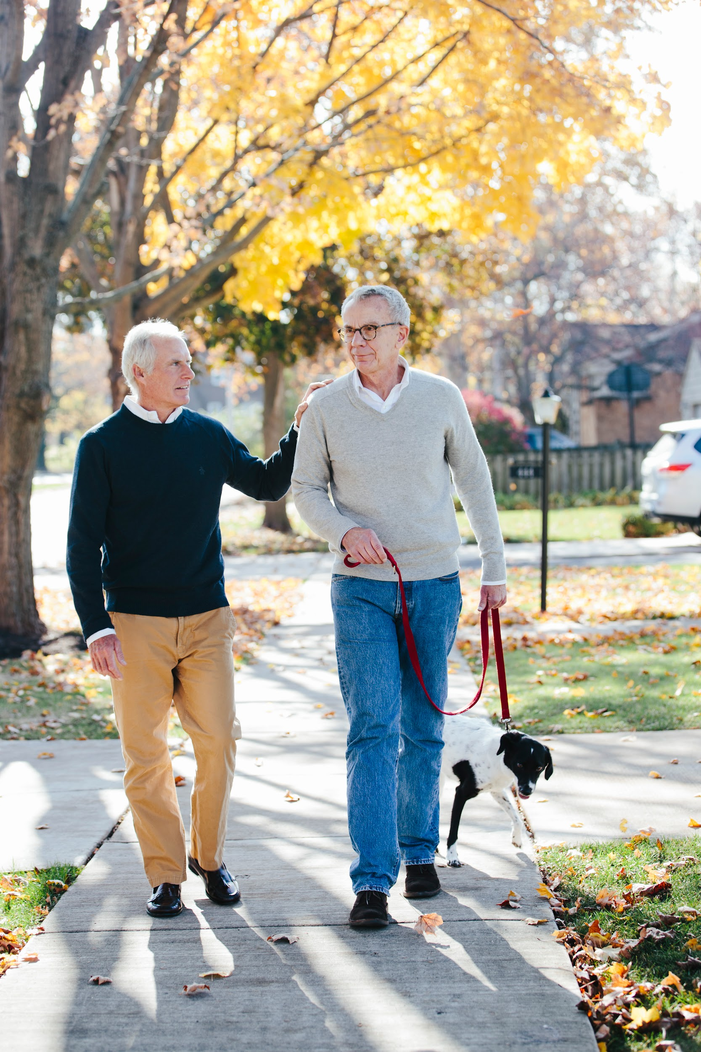

The first large-scale, randomized controlled trial in the U.S. to evaluate whether addressing several lifestyle factors at the same time – diet, exercise, cognitive stimulation, and heart health – can protect cognitive function in older adults at increased risk for cognitive decline.
Notes:
The 10 Healthy Habits showed us that many health behaviors and conditions can affect the risk of cognitive decline and dementia. And now we have evidence that doing something about them can have a positive impact on brain health.
The US POINTER study showed that a program combining exercise, nutrition, cognitive engagement and health monitoring can meaningfully protect brain health. This was a randomized controlled clinical trial that tested two lifestyle interventions in a large, diverse population of older adults at risk for cognitive decline and dementia. Participants were in either a self-guided or structured lifestyle program. Cognitive function improved for both groups but the structured group showed the greatest benefit – performing at cognitive level comparable to adults nearly 2 years younger.
This is a very important study that underscores the message that healthy behaviors have a powerful impact on our brain health.

Slide 16

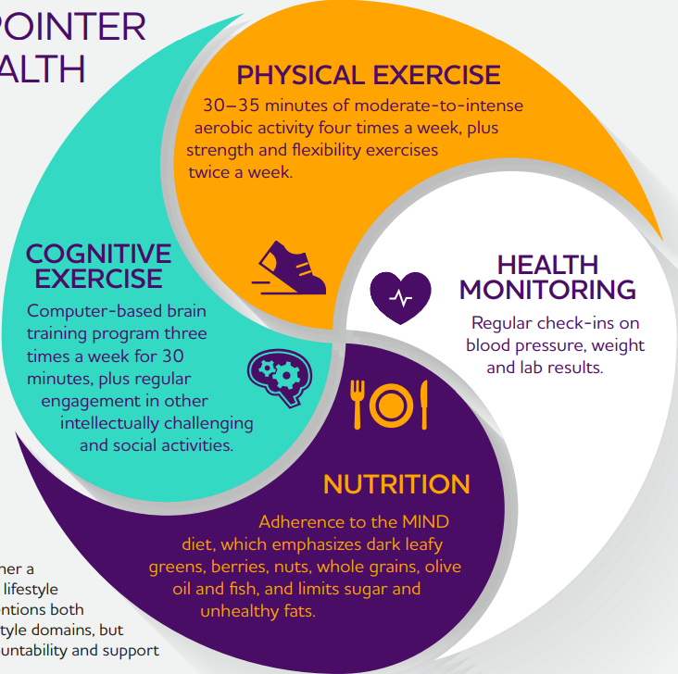
THE U.S. POINTER BRAIN HEALTH RECIPE*
*Participants followed either a self-guided or structured lifestyle program. The two interventions both focused on the same lifestyle domains, but differed in structure, accountability and support provided.
Notes:
You can see here the brain health recipe that the structured group followed.
The US POINTER brain health recipe includes:
A balanced exercise routine that includes 30-35 minutes of aerobic exercise (like jogging or dancing that really gets your heart pumping) four times a week, along with strength or resistance exercises (lifting weights, for example) and stretching and balance activities.
Having blood pressure, blood sugar, and weight regularly checked by a health care provider.
Following the MIND diet, including eating dark leafy greens, berries, nuts, whole grains, olive oil and fish. And limiting sugar and unhealthy fats.
Regularly exercising and challenging the brain

Slide 17
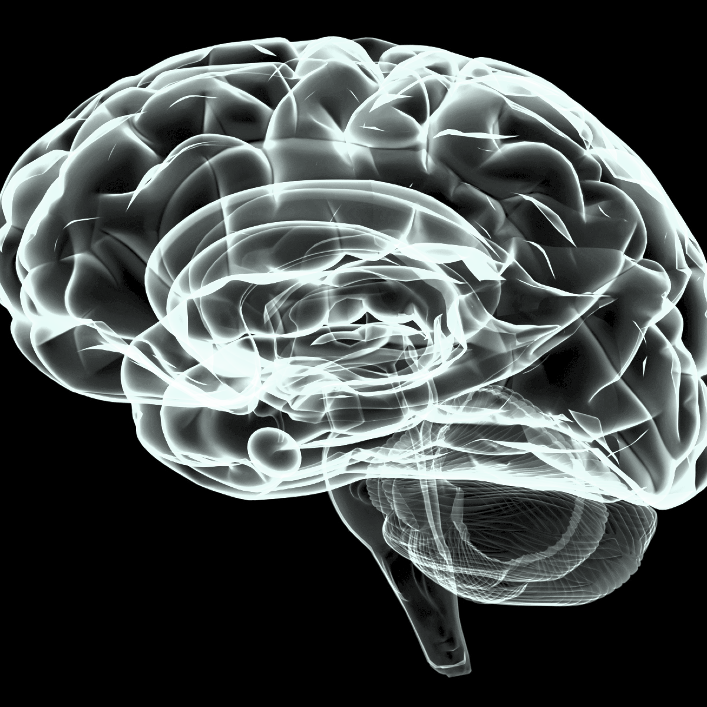





Take Charge of Your Brain Health
There are several risk factors for cognitive decline and dementia. Some, such as age, we can’t control. But there are actions we can take to improve our brain health.
Growing evidence shows that healthy living can lower the risk of cognitive decline and possibly dementia.
Our brains need to be taken care of at all ages. It is never too early or too late to take action to protect brain health.
Notes:
Remember that what we do every day can make a real difference in protecting our brain health. .
The U.S. POINTER study showed that we CAN take charge of our brain health. It is never too early or too late to start.
Remember the 10 Healthy Habits for Your Brain and the U.S. POINTER Brain Health Recipe, and think about what you can do to build more brain-healthy habits into your daily living.

Slide 18



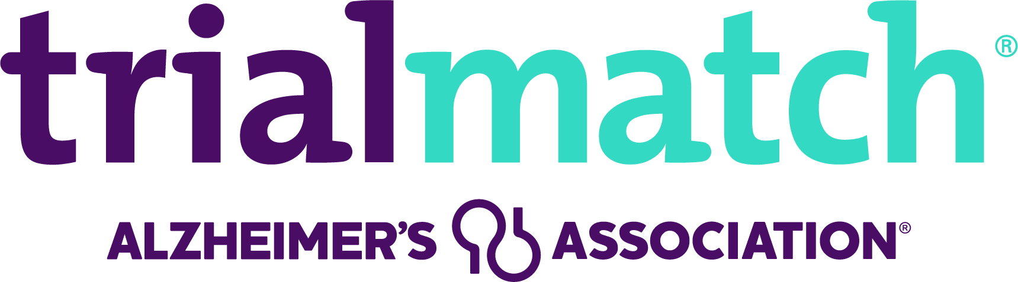
24/7 Helpline
The Alzheimer’s Association 24/7 Helpline (800.272.3900) is a free service offering confidential information and support for people living with dementia, caregivers, families and the public.
Free Education and Support
The Association offers robust information, education and support both in person and online, and helps to connect individuals with resources in the community.
TrialMatch®
The Association connects individuals living with cognitive impairment, Alzheimer's disease or another dementia, caregivers and healthy participants with current research studies. This free, easy-to-use service helps you find clinical research that may be a good fit.
Notes:
I want to make sure you know about the ways the Alzheimer’s Association can help you and your community. No matter where you are on your journey, you are not alone.
The free 24/7 Helpline at 800.272.3900 is always open, day or night, weekends and holidays. Whether you’re living with dementia, caring for someone who is, or just looking for answers, trained professionals are ready to provide confidential support, guidance and information.
The Alzheimer’s Association website, alz.org, is a powerful tool. It connects individuals and families to local programs, services and educational resources. Whether you’re looking for support groups, care planning tools or information about the disease, it’s all there easy to access and always free.
We also offer education and support programs, both in-person and online. These programs cover everything from the basics of Alzheimer’s to advanced caregiving strategies and professional training. They’re designed to reach all communities and are delivered by trusted staff, volunteers and partners. Many are also available on-demand, so you can learn at your own pace.
For caregivers and those living with dementia, we provide compassionate, community-based support. This includes support groups, both virtual and in-person, and ALZConnected®, our free online community where people can share experiences and find encouragement from others who truly understand.
We also offer tools like ALZNavigator, an interactive guide that helps families create personalized action plans based on their unique needs. And through local partnerships, we provide early-stage social engagement programs to help people stay connected and active.
Alzheimer’s Association TrialMatch® connects individuals living with cognitive impairment, Alzheimer's disease or another dementia, caregivers and healthy participants with current research studies. This free, easy-to-use service helps you find clinical research that may be a good fit, whether you're focused on treatment, diagnosis, care or prevention. Confidentially search hundreds of drug and non-drug studies, sign up, receive email notifications about new opportunities and connect directly with research teams.
At the Alzheimer’s Association, we’re more than a resource, it’s a partner in your journey here for you, every step of the way.

Slide 19
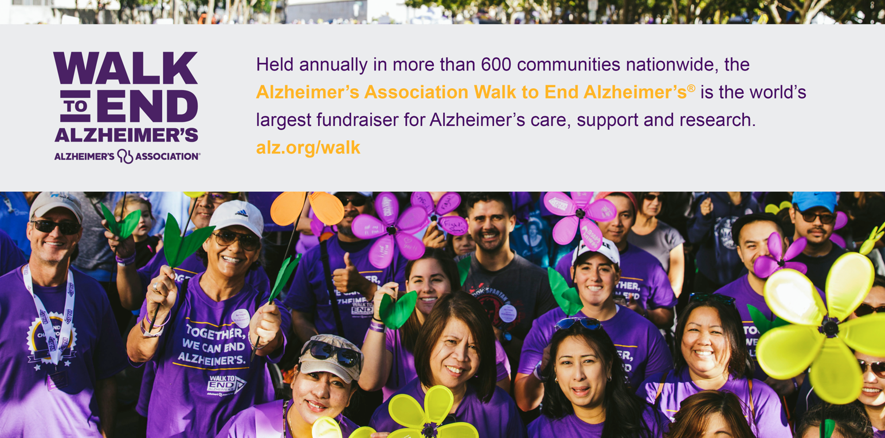
Notes:
To help fuel our mission, we engage volunteers at every level of our organization and raise funds to support our efforts. Often, our fundraising events are the entry point for individuals to volunteer with the Association. Let’s talk a little bit about each of our signature events.
Held annually in more than 600 communities nationwide, the Alzheimer's Association Walk to End Alzheimer's® is the world's largest fundraiser for Alzheimer's care, support and research. The event calls on participants of all ages and abilities to join the fight against the disease.

Slide 20
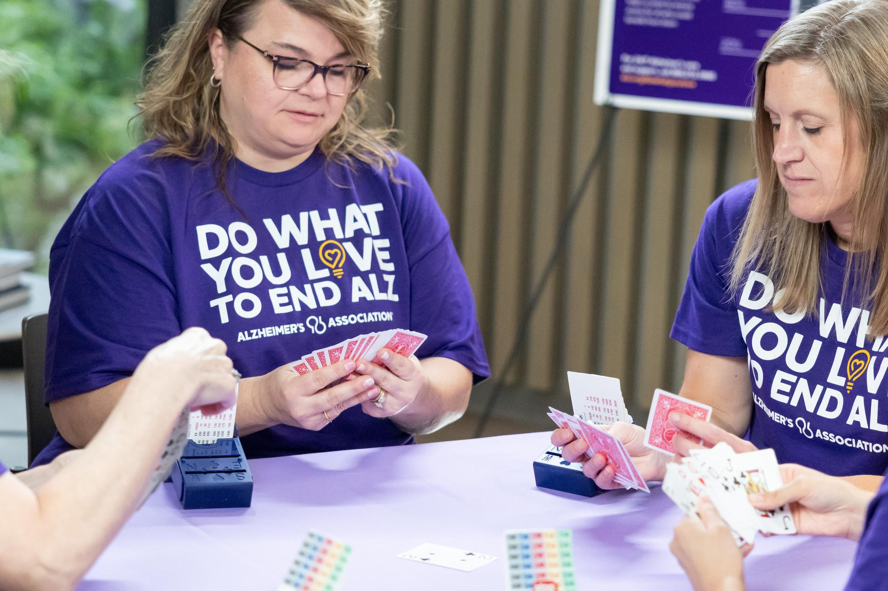
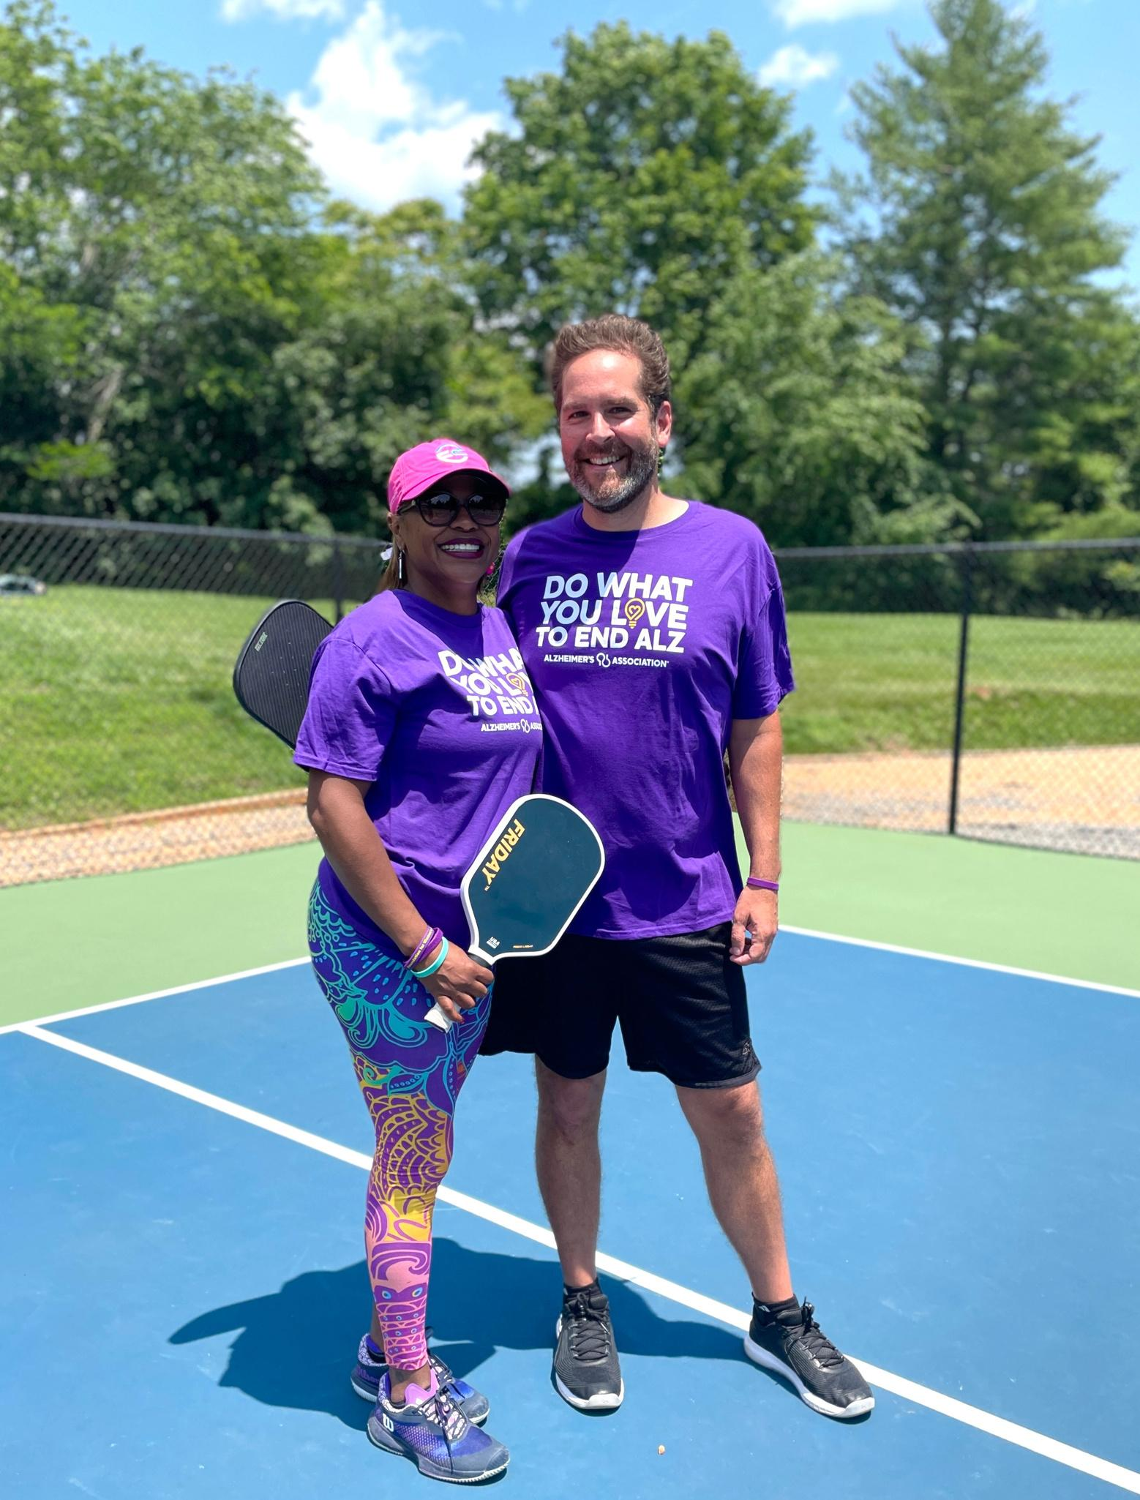


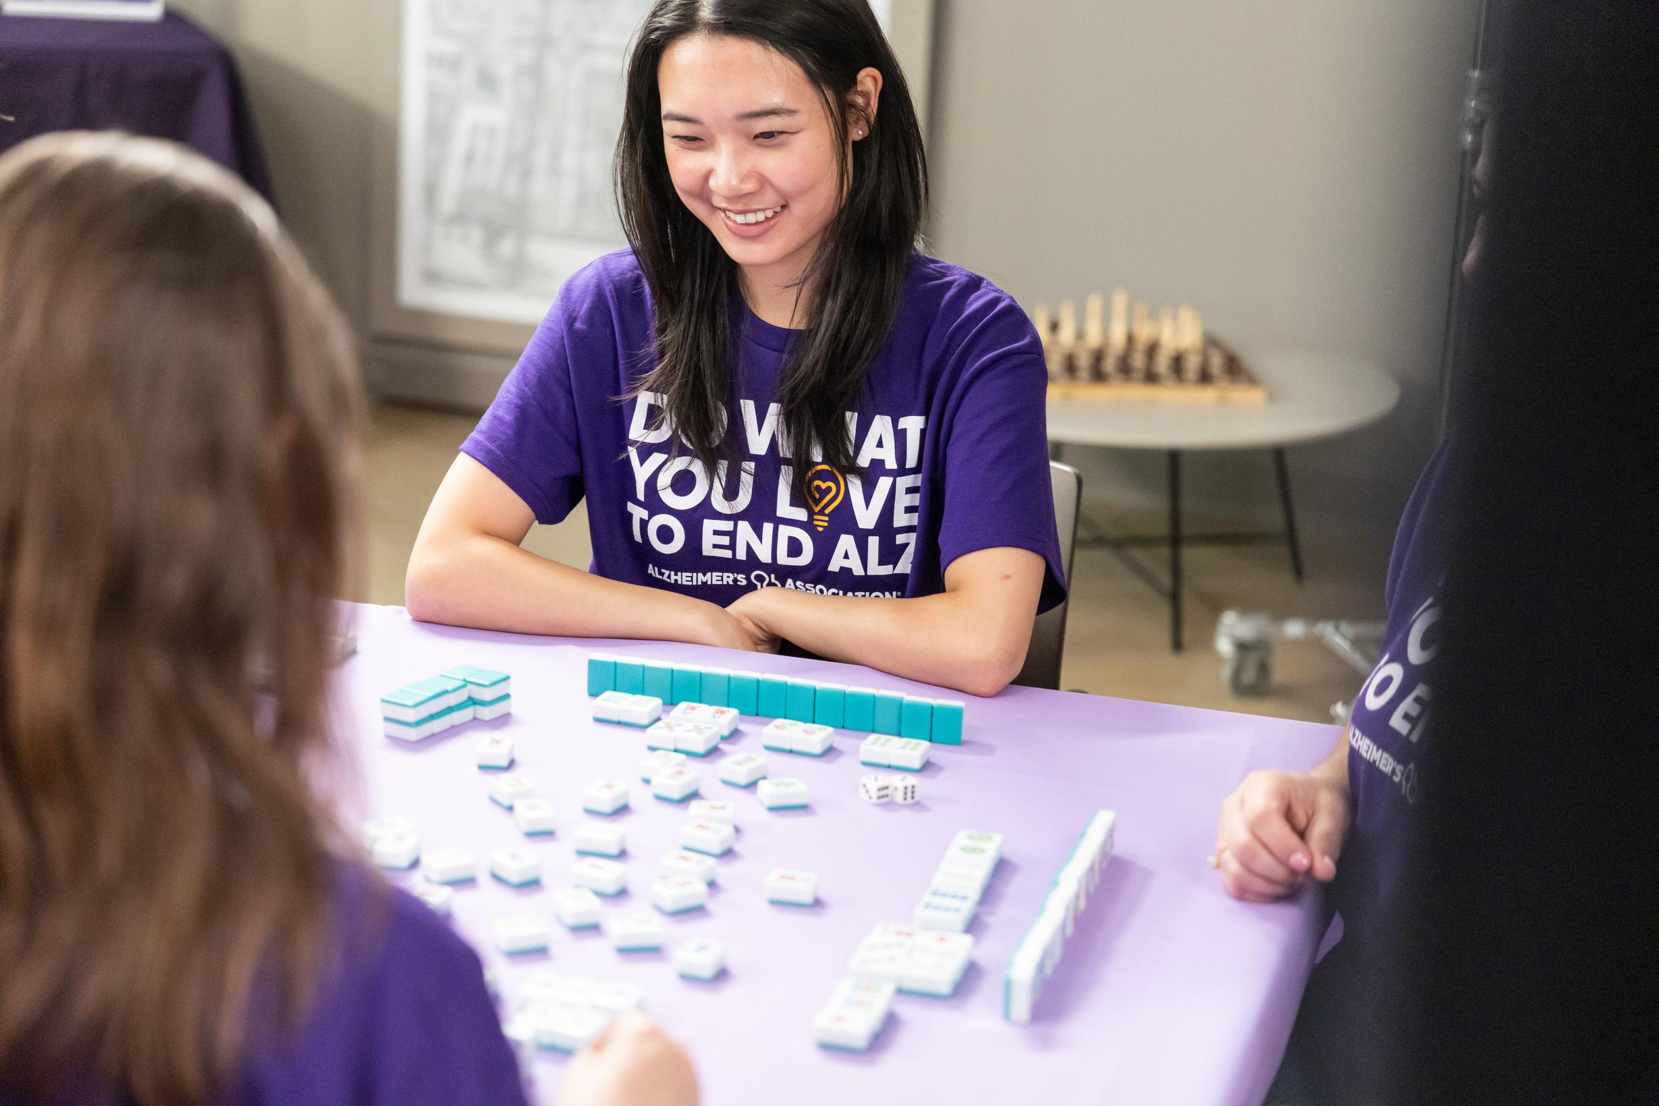


Do What You Love to End ALZ makes it easy to make a difference. It’s simple, flexible and starts with you — doing something you love and turning it into a fundraiser to end Alzheimer’s and all other dementia.
There’s no limit to what you can do!
From hiking, golfing, gaming, or crafting, to playing pickleball or bridge, hosting a cookout or purple party — choose your passion, add the power of your community, and get started.
alz.org/dowhatyoulove
Notes:
"Do What You Love to End ALZ" is a personalized fundraising initiative by the Alzheimer's Association that builds on the success of their previous event, The Longest Day. This refreshed campaign invites individuals to turn their passions into purpose by choosing any activity they love — whether it's baking, biking, painting, gaming, or anything else — and using it to raise funds and awareness for Alzheimer's and other dementias.
[TELL YOUR STORY: “As a volunteer, my Walk team brings our family together to honor my XXXX while we raise awareness and funds for the mission.”]

Slide 21


Join us to take action for brain health
Spread the word! Tell others about these brain-healthy habits.
Get involved in clinical trials or a research study. Some studies focus on prevention.
Fight Alzheimer's through a fundraising activity of your choice on a day that works for you. Visit alz.org or call our helpline to learn more.
✔
✔
✔
✔
Notes:
You have the power to help us move closer to our vision: a world without Alzheimer’s and all other dementia.
The Alzheimer’s Association offers a wide range of volunteer opportunities to match every interest, skill set and schedule. Whether you’re passionate about advocacy, education, event planning or simply lending a helping hand, there’s a place for you.
By sharing your time and talents, you can make a meaningful impact in your community and connect with others who share your passion for making a difference. Whether you want to get involved on your own, with a service club, your workplace or a group of friends, we’ll help you find the role that’s the right fit.
And if you’re here today because someone you care about is affected by Alzheimer’s, know that we’re here for you too with support, resources and a community that understands.
Together, we can create change.To learn more or get started, reach out to the Alzheimer’s Association.

