Slide 1
NARFE Update
Our Accomplishments
Presented by
Cindy Renee’ Blythe
National Secretary/Treasurer

Slide 2

Welcome and Introduction
Current Budget Situation
Dept of Homeland Security 81,962
Current number of federal civilian employees working without salary
Coast Guard – 9,962
TSA – 64,000
ICE – 8,000

Slide 3
National Executive Board (NEB)
March 2026
2026 Operating Budget
Increased Matching Funds program
2025 Audit has begun
NARFE Magazine
Mid-year budget review
Explore new avenues for non-dues revenue
Lessen dependence on membership revenue

Slide 4
National Executive Board (NEB)
FEDCon26
August 23-25, 2026, Indianapolis, IN
Hyatt Regency Indianapolis
Registration Fees
Early Bird $225/$300 May 22, 2026
$250/$300 May 23 thru August 7, 2026
$300 August 8 and on-site
Room Rate
$179 Conference Rate, booking deadline June 29th
Group Code – G-NARF
https://fedcon.narfe.org/why-attend-fedcon26/

Slide 5

FEDCon26
Breakout Sessions
Advocacy
NARFE Leadership
Federal Benefits
Active Federal Employee
Lifestyle
Proposed Bylaw and Standing Rule
Amendments

Slide 6
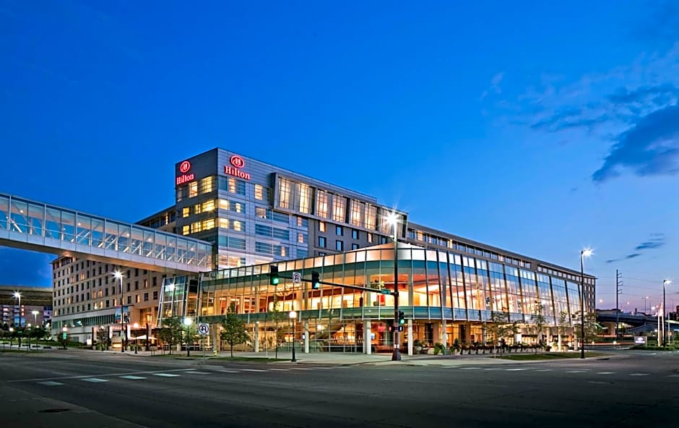
Future Plans/Save the Date
NEB/FP Meeting
August 22-26, 2027
Hilton Downtown –
Omaha NE
FEDCon28
August 23-29, 2028
$122 Room rate
Airport shuttle
Every half hour
Complementary

Slide 7

Membership
Stabilization
156 net loss
Lost 14,353 in 2022
9.12% of membership
125,422 total members
72,225 NO
53,197 Chapter
550 Chapters

Slide 8

Recruiting Opportunities
Street Level Studios
Love Rutledge, FedUpward LLC
John Hatton
Tammy Flanagan
Brian Levine
2 New Domains (url’s)
joinnarfe.org
joinnarfe.com
New Members
99 digital marketing

Slide 9

Recruiting
Federation Recruiting Success
118 New Members in 2025
Open Season
Illinois
Rhode Island
Kentucky/Tennessee
Ohio
Texas
Colorado

Slide 10
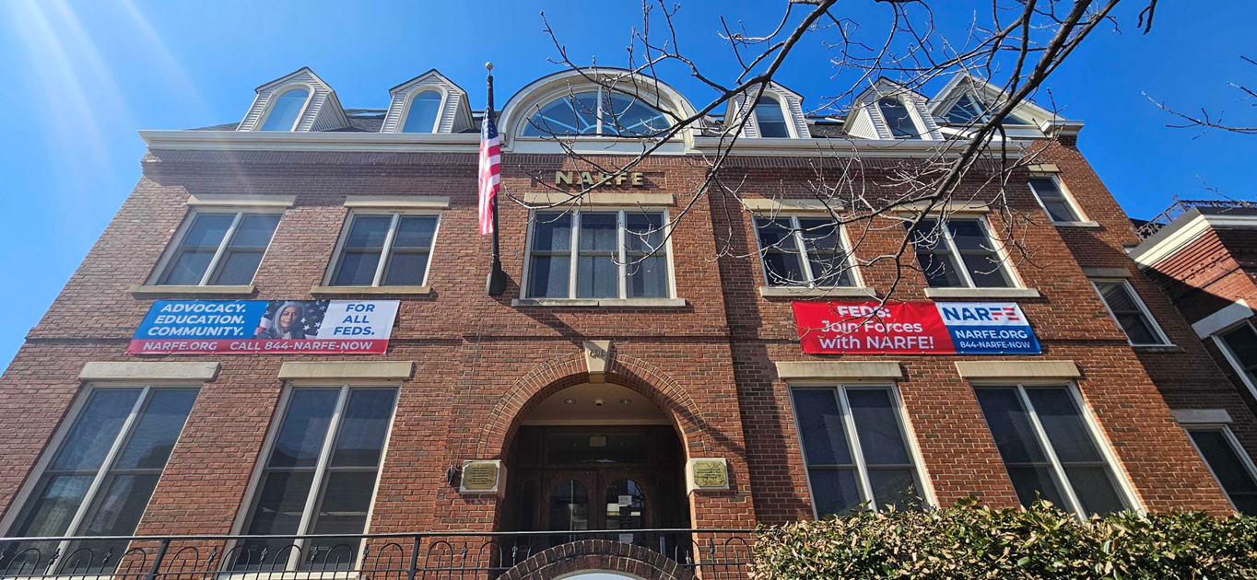
National Bylaws
Available on the NARFE website
Three-year term for all National Officers
New books available September
990-N
May 15th deadline
500 chapters
61 lost tax-exempt status
Closed chapters
62 in 2025

Slide 11
Strategic Initiatives
Strategic Plan
Clear specific goals
Track progress
Evaluate performance
2027-2028 National Election
Last day of FEDCon26
Statements on FEDHub

Slide 12
Liability Insurance
$100.00
June 12th deadline
Received after the deadline
What’s Next
Modern platform
Identify and correct reporting
issues
Better serve members

Slide 13
Thank you for the invitation!!
Thank you for the invitation
cblythe@narfe.org
natsectreas@narfe.org
Questions??

Slide 14
Thank you!
Cindy Renee’ Blythe
cblythe@narfe.org

