Slide 1
Illinois Federation Conference Evolving Advocacy: NARFE’s Grassroots Toolbox for Today and Tomorrow
Ivana Sara
Grassroots Advocacy and Legislative Affairs Manager

Slide 2
Agenda
Legislative/Advocacy Update
Power of Grassroots Advocacy
What it means to be an advocate
NARFE’s Grassroots Toolbox
Grassroots Statistics
Benchmarks
Innovations in Grassroots Advocacy

Slide 3
Legislative Update
The Social Security Fairness Act, H.R. 82/S. 597
329 cosponsors in House (as of 10/15/24) -2nd most cosponsored bill in all of Congress
62 cosponsors in Senate (as of 10/15/24)
We have now moved to support a discharge petition to bring H.R. 82 to the floor for a vote
(Filed 9/10/24- Discharge Petition #16)
218 signatures required, bypassing Committee process
9/18: 189 signatures! (Check clerk.house.gov)
9/9/24 NARFE sent letter to Congress
Use LAC to contact Rep.!
S. 597 June Hearing in Columbus, OH
Sens. Brown (D-OH) & Collins (R-ME) call for floor vote S. 597

Slide 4
Legislative Update
More Accurate COLAs for FERS Retirees
Support of the Equal COLA Act, H.R. 866/ S. 3194, ensuring FERS COLAs match the change in consumer prices (and the CSRS COLA)
71 cosponsors for H.R. 866 as of 10/15/24
8 cosponsors for S. 3194 as of 10/15/24
If CPI increases above 2%, FERS retirees do not receive full COLA
If between 2% and 3%, FERS COLA = 2%
If above 3%, FERS COLA = CPI minus 1%
2025 Cost-of-living adjustment determined-2.5% CSRS, 2% FERS

Slide 5
Legislative Update
Improving Government and Protecting the Merit System
Saving the Civil Service Act, H.R. 1002/S.399
Prohibit return of Schedule F, protect merit based civil service
68 House sponsors (as of 10/15/24)
18 Senate sponsors (as of 10/15/24)
9/17- HSGAC Hearing & Mark-up 9/18
Threats to Merit Based Civil Service Continue
Public Service Reform Act, H.R. 3115/S.1496
Would eliminate the merit-based civil service entirely, abolishing the Merit Systems Protection Board (MSPB),
Schedule F
Created via executive order at end of Trump administration
Effort by large coalition of conservative groups, led by the Heritage Foundation
Would reclassify employees identified as holding positions of a “confidential, policy-determining, policy-making, or policy-advocating” character in a new excepted service schedule, without protection of competitive service rules
Interpreted broadly, could apply to 50,000, or even more, federal employees
OMB identified 68 percent of employees for reclassification

Slide 6
Legislative Update
Federal Pay
Support market-rate federal pay increases
FY ‘24 Biden issued alternative pay play to provide 4.7% across-the-board increase, plus 0.5% increase to locality pay (signed into law 12/23)
For 2025, NARFE supports a 4.5% increase with 4% across- the board increase, plus 0.5% increase for locality (market-rate)
On August 30, President Biden has officially released his alternative pay plan for 2025,
An average 2% federal pay increase with 1.7% across-the-board increase with an additional 0.3% increase in locality pay rates
Goes into effect 12/24
NARFE supports FAIR Act- 7.4 percent pay increase for federal employees in 2025 with a 4% across-the-board increase, and a 3.4% average increase to locality pay rates.

Slide 7
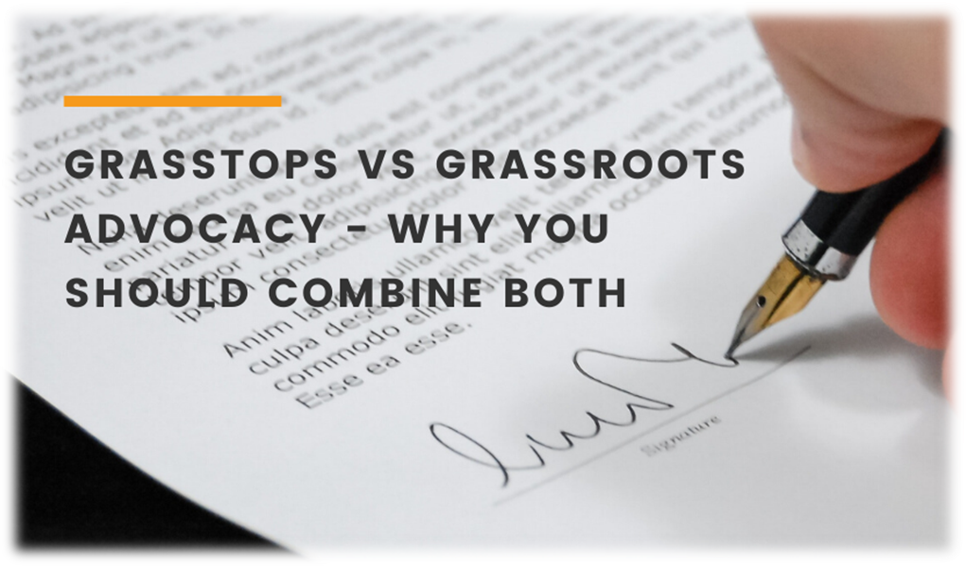
Power of Grassroots Advocacy
Does Grassroots Activism Still Work?
Symbiotic relationship
What does it mean to be an advocate?
Grassroots v Grasstops
Members v Leaders

Slide 8
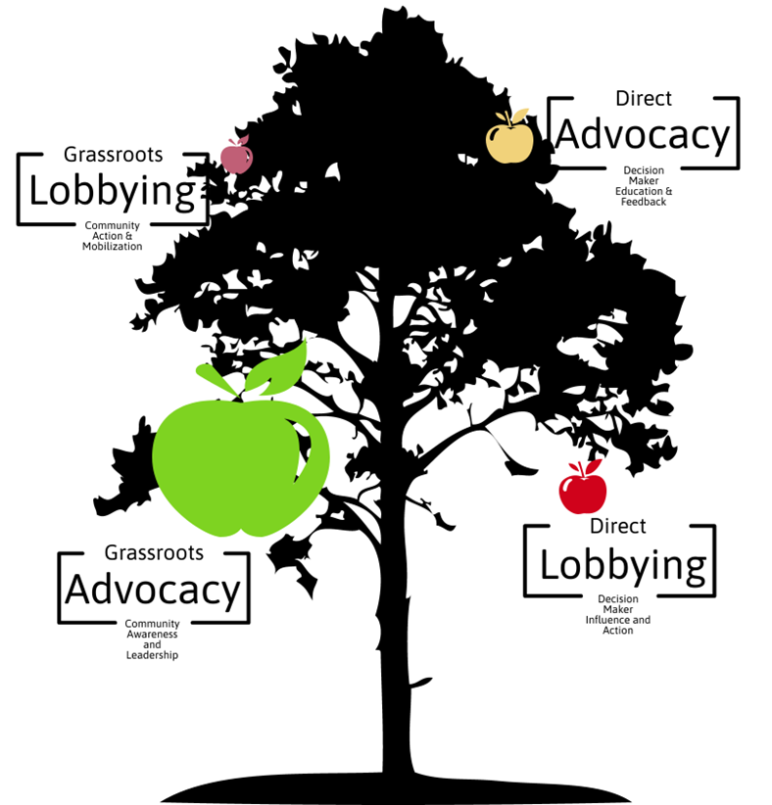



Power of Grassroots Advocacy
Does Grassroots Activism Still Work?
Advocacy Tree
“Bottom” up approach
NARFE-PAC
LOBBYING
GRASSROOTS

Slide 9


Power of Grassroots Advocacy
Does Grassroots Activism Still Work?
Beyond the Advocacy tree
Coalitions

Slide 10
How do we get the job done?

Slide 11
NARFE’s Grassroots Toolkit
The many ways we advocate
How effective are our tools?
The different ways our tools work
Action | Resources
Action Letter/ Emails | Issue Briefs
Social Media | Fact Sheets
Phone Banking | Educational Videos/ Podcasts*!
Letter to the Editors (LTEs) | Talking Points/Phone Scripts
Meetings with Lawmakers/Staff | Meeting Requests
Town Halls/ Community Events | Guides

Slide 12
NARFE’s Grassroots Toolkit
The many ways we advocate
Why do we take the specific actions we take?
Why does NARFE tell you to do use these tools?
Repetitive actions-valuing consistency
Action | Resources
Action Letter/ Emails | Issue Briefs
Social Media | Fact Sheets
Phone Banking | Educational Videos/ Podcasts*!
Letter to the Editors (LTEs) | Talking Points/Phone Scripts
Meetings with Lawmakers/Staff | Meeting Requests
Town Halls/ Community Events | Guides

Slide 13
NARFE’s Grassroots Stats

Slide 14


NARFE’s Grassroots Toolkit
How effective are our tools?
Measuring action
Action letters- 79%
Personal stories- 29x
LTEs- 80%
Meetings with Lawmakers- 65%
Recall rate:45%

Slide 15
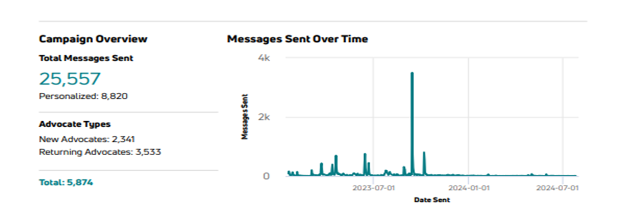
NARFE’s Grassroots Toolkit
Member activity stats
WEP/GPO Repeal bill, H.R. 82/S. 597
Jan. 2023-Dec. 2023

Slide 16
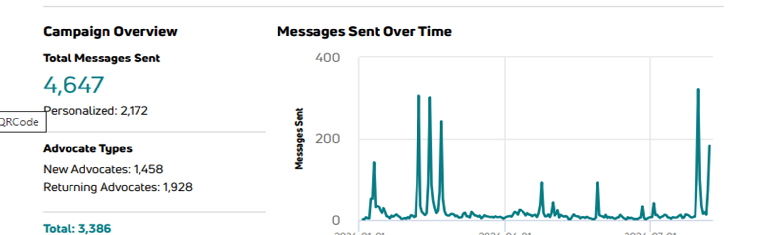
NARFE’s Grassroots Toolkit
Member activity stats
H.R. 82 Committee Action
Jan. –July 2024
H.R. 82 Discharge Petition
July 30 2024

Slide 17
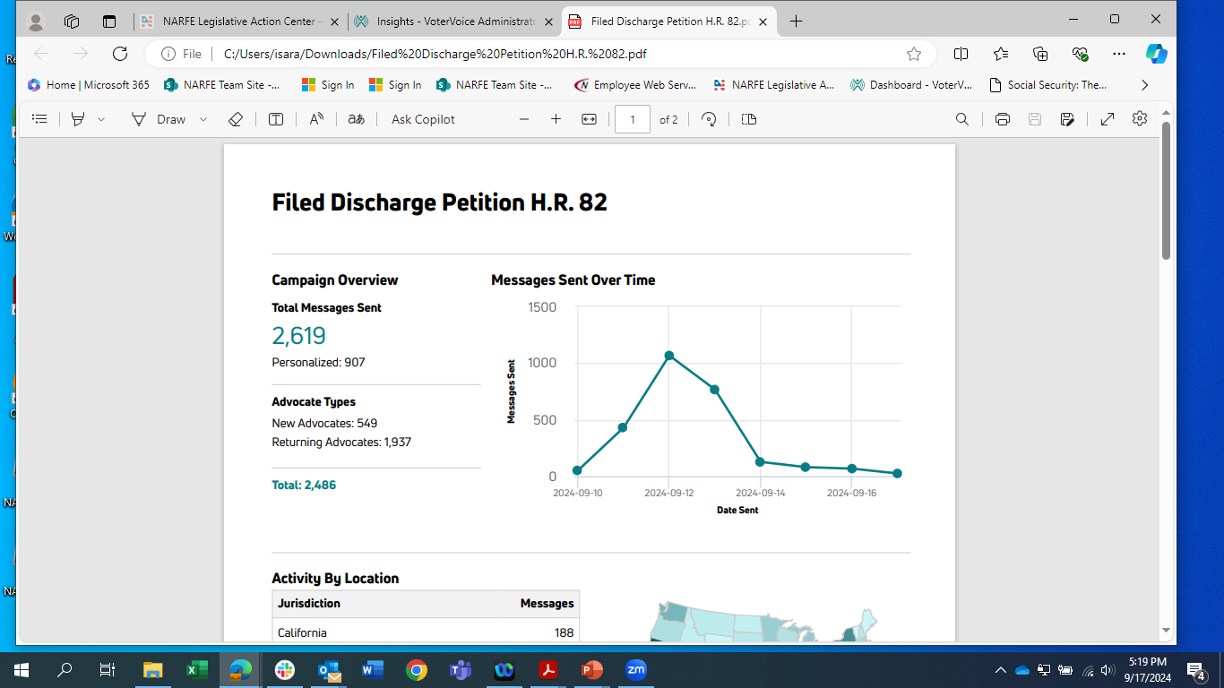
NARFE’s Grassroots Toolkit
Member activity stats
H.R. 82 Discharge Petition
Filed September 10th → Requesting Signatures for H.R. 82 Petition

Slide 18



NARFE’s Grassroots Toolkit

Slide 19
GAM 2024
Recapping Grassroots Advocacy Month (GAM 2024)
GAM ‘24 Priorities:
Social Security Fairness Act H.R. 82/S.597, Saving the Civil Service Act H.R. 1002/S. 399, Equal COLA Act H.R. 866/ S. 3194
How did we do?
Action Letters- Aug. 1- 31- 5969 letters sent across all campaigns including Twitter (“X”), and LTEs
Up from last year! (2881)
LTEs: 467 (please notify, if published!)
Meetings/interactions with lawmakers: 30 noted via event feedback form

Slide 20


Innovations in Grassroots Advocacy
How Benchmarks come into play
Why Benchmarks emerged
What are they?

Slide 21
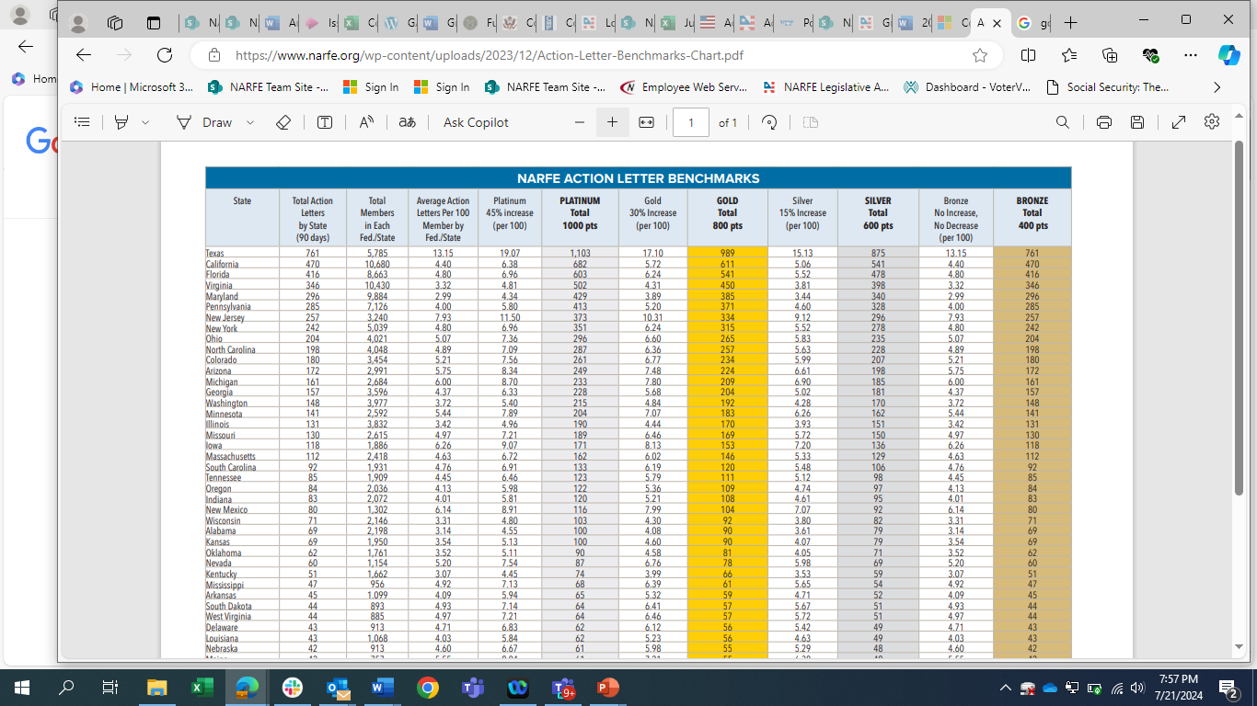
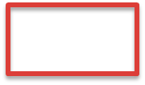
Innovations in Grassroots Advocacy

Slide 22
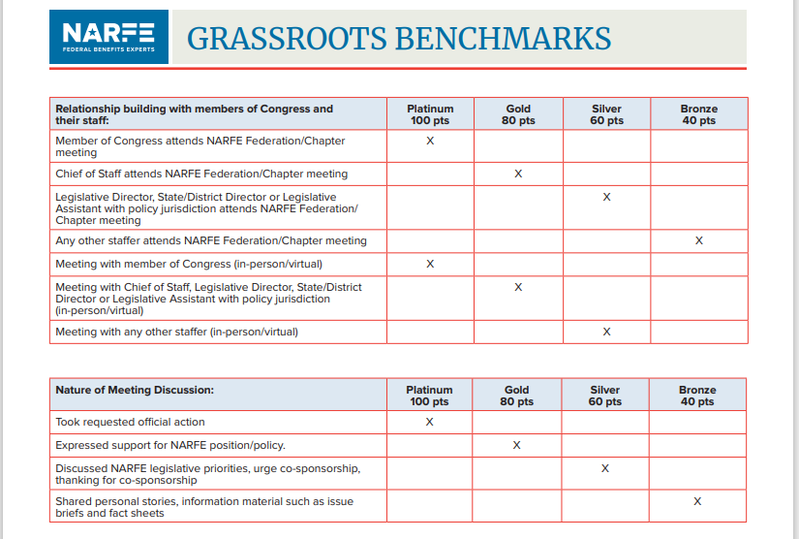
Innovations in Grassroots Advocacy

Slide 23
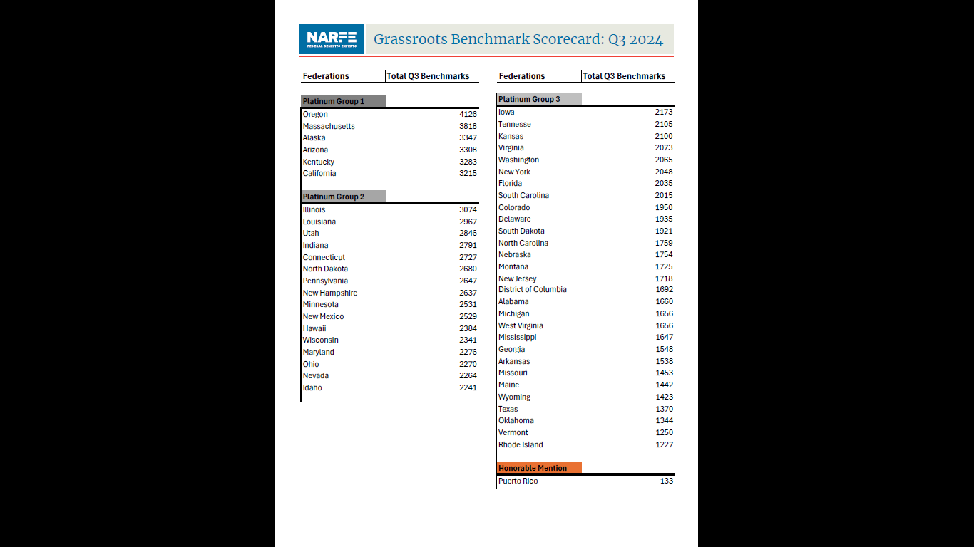

Slide 24
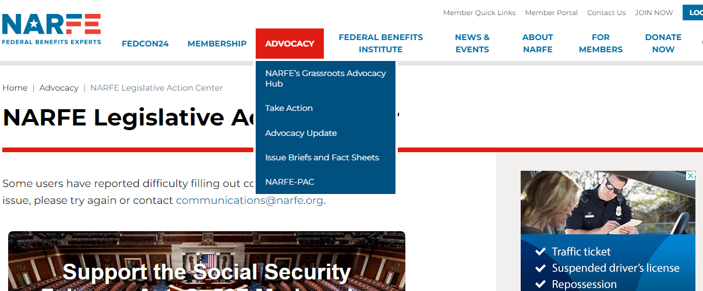
Innovations in Grassroots Advocacy

Slide 25
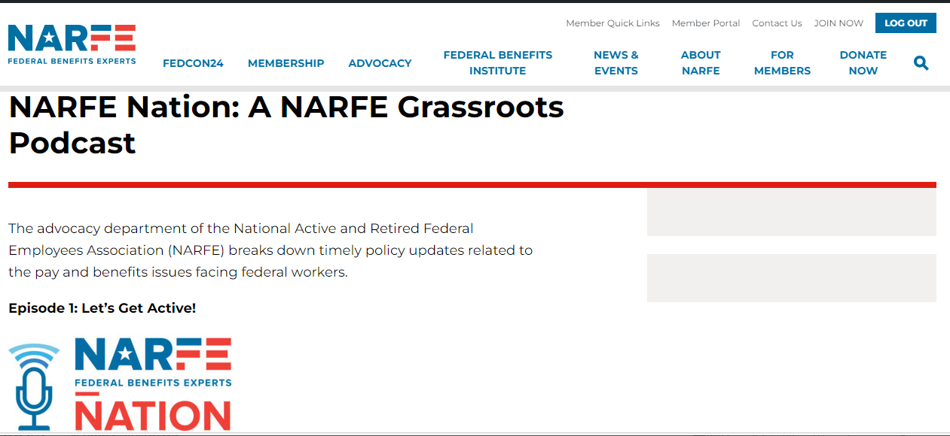
Innovations in Grassroots Advocacy

Slide 26
What does the future hold?

Slide 27
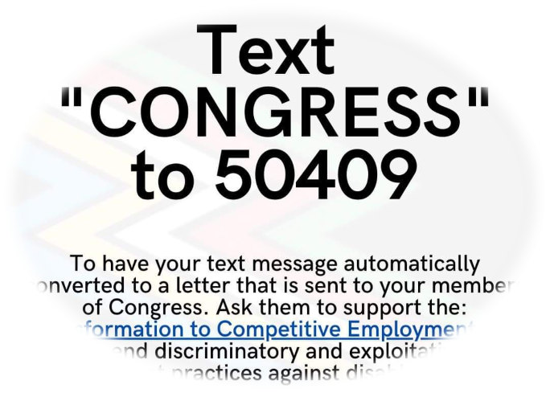
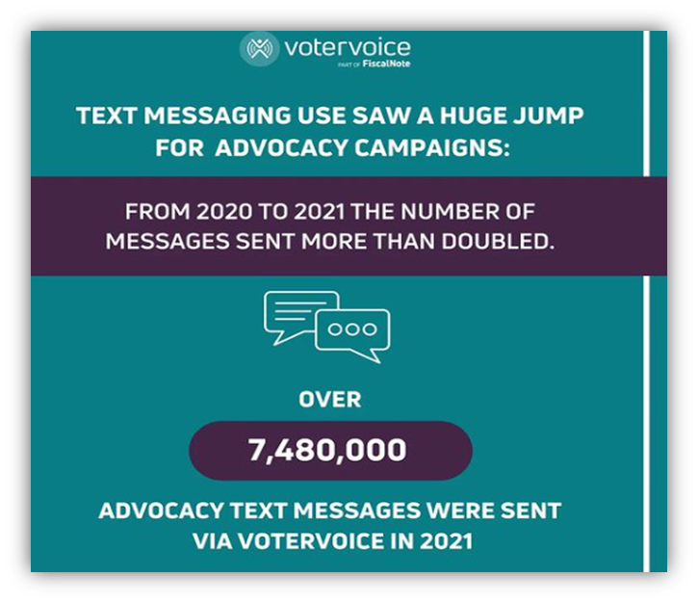
Innovations in Grassroots Advocacy
How has Advocacy evolved?
Traditional v. Modern advocacy
Advocacy Platforms
Advocacy Maps
Social Media
Virtual Town Halls
What could be next?
Artificial Intelligence (AI)
Augmented Reality (AR)
Crowd-sourcing

Slide 28

Innovations in Grassroots Advocacy
How has Advocacy evolved?
Traditional v. Modern advocacy
Advocacy Platforms
Advocacy Maps
Social Media
Virtual Town Halls
What could be next?
Artificial Intelligence (AI)
Augmented Reality (AR)
Crowd-sourcing

Slide 29
Thank You Illinois Federation! Q&A

